Slide 1
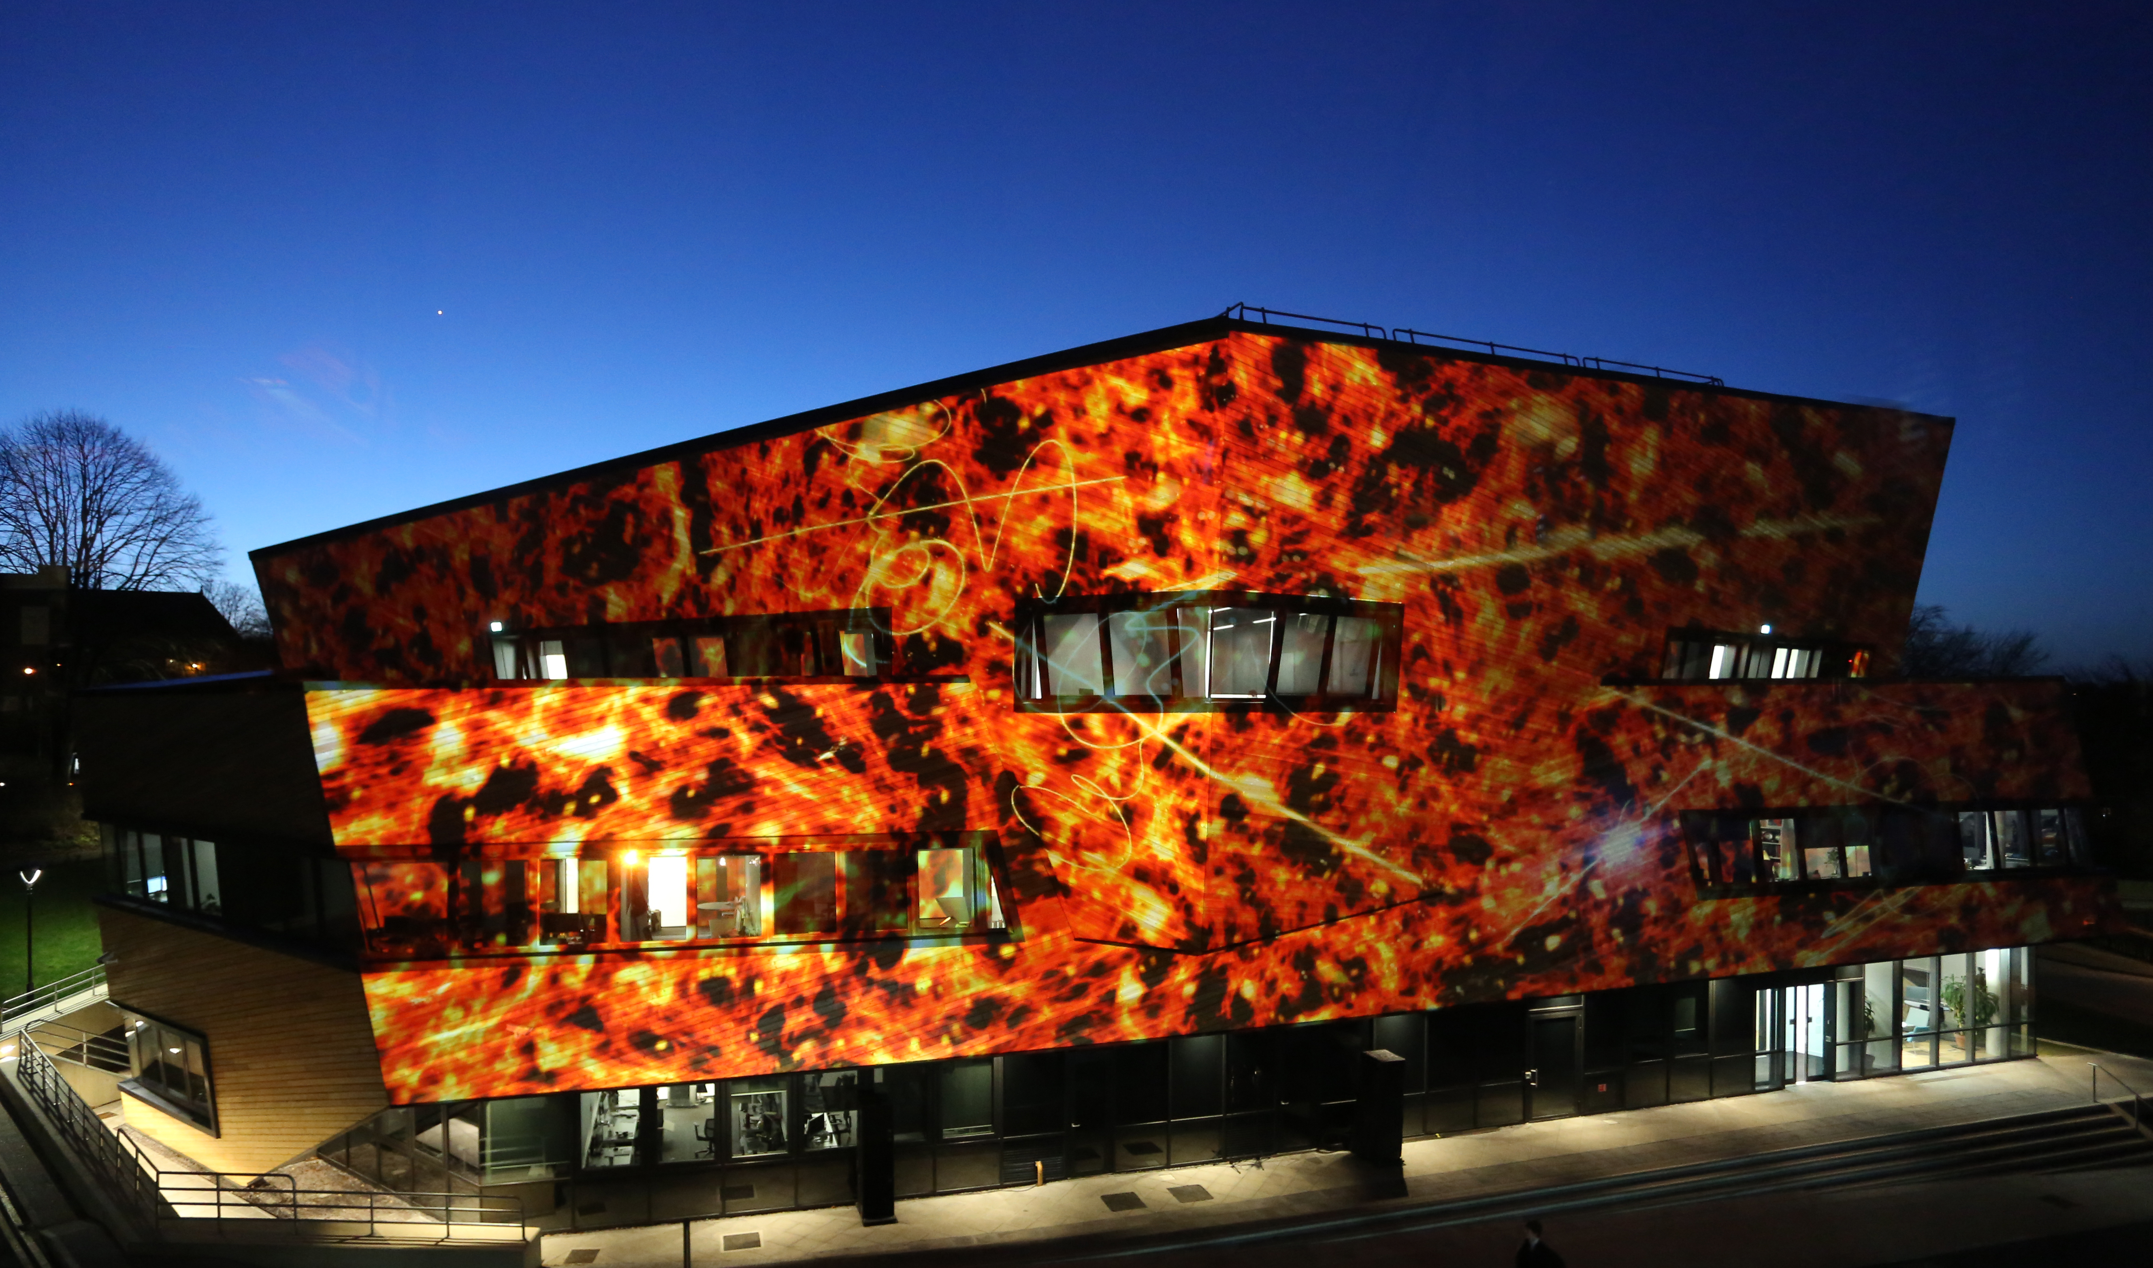
Science as a global endeavour
The new Ogden Centre at Durham

Slide 2
Science as a global endeavour
Modern science is an international endeavour in which the UK is a genuine world power
The UK (ranked 4th) produces 8% of the world’s research papers, but has only 0.87% of the world’s population
Why is the UK so good at science?
→ NOT thanks to generous funding!

Slide 3
UK
Government investment (as fraction of GDP)
USA − 0.85
Germany − 0.90
UK − 0.52
EU: domestic expenditure in R&D as % of GDP (2016)

Slide 4
EU: domestic expenditure in R&D as % of GDP (2016)
EU 2020 goal
Government investment (as fraction of GDP)
USA − 0.85
Germany − 0.90
UK − 0.52

Slide 5
Why is the UK so good at scientific research?
Five reasons why UK overachieves in science:
Long tradition of scientific research
→ Efficient resource allocation based on high quality peer review
Educational system that encourages curiosity & independence
Open doors to best researchers in the world
Membership of EU
(That world science is conducted in English helps)
2, 4, 5 are under now under threat from eg REF and Brexit

Slide 6
The UK as an international hub for scientific research
In UK universities:
28% of academic staff are non-UK nationals (mostly EU)
50% of PhD students are non-UK nationals
21% academic staff in STEM are from EU

Slide 7
International nature of scientific research
CSF:
Undergrad (Physics) – Mexico City, Mexico
PhD (Astrophysics) – Cambridge, UK
Postdoc 1 – Berkeley, CA, USA
Postdoc 2 – Sussex/Sta Barbara, UK/USA
Academic staff – Durham, UK
 | Number | No of nationalities
PhD students | 34 | 12
Postdocs | 37 | 23

Slide 8
Institute for Computational Cosmology Durham University
ICC | Number | No of nationalities
Academics | 13 | 6
Postdocs | 17 | 10
PhD students | 28 | 10
Support | 10 | 4

Slide 9
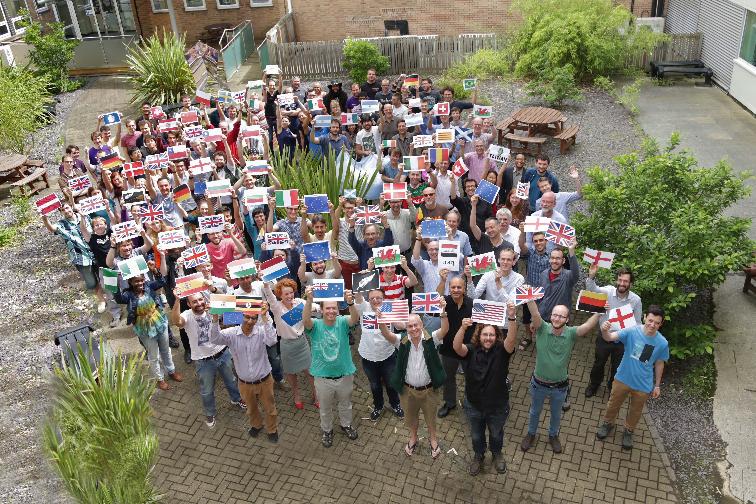
Physics, Durham University – June 2016

Slide 10
Why is the best science international?
Biggest problems are too big for single nations to tackle
Greater pool of talent
Greater resources
CERN: Bugdet -- £0.875 billion
22 member states; 8 associate member states; cooperation agreements with 36 countries;
Facilities used by 600 universities and institutes
European Space Agency: Budget -- £4.9 billion
22 member states; 1 associate member state; cooperation agreements with 8 countries

Slide 11
Why is the best science international?
International teams combine different expertise, skills and talents
Most cited paper in astrophysics/space science in 2015
22 authors – 12 countries
Argentina Belgium Canada China Germany Iran Ireland Italy Mexico Netherlands UK Switzerland
Argentina Belgium Canada China Germany Iran Ireland Italy Mexico Netherlands UK Switzerland

Slide 12
Brexit: a potential disaster for UK science
Of the world’s research outputs:
Europe produces → 39%
USA → 25%
UK → 8%
60% of UK’s collaborative papers have European co-authors
With Brexit, we are leaving the most productive and one of the best funded science blocks in the world
Between 2007 and 2013,
UK contributed €5.4bn to EU R&D
But received €8.8bn
ERC:
UK-based researchers received
€1.7 bn (22.4% of total)
UK contributes 10.5% of EU budget
Total funding for R&D (2016, billions of US dollars)
USA → 495
EU → 345
China → 279
UK → 42

Slide 13
Brexit: a potential disaster for UK science
Funding is not even the key issue
The key issue is the quality of the programmes that the EU funds
E.g. ERC:
Funds fundamental science
Purely on basis of excellence
Long term (5 years) at various stages of career
Rigorous peer review
Highly cited papers:
37% by ERC-funded UK researchers with EU collaborators
13% UK authors funded by any other source

Slide 14
Brexit: a potential disaster for UK science
4 key strategic goals to mitigate effects of Brexit:
Continued full membership of EU Framework programmes (Horizon Europe)
Mobility of EU scientists (“scientist’s passport” or cheap, bureaucracy-free, long-term visa )
Continued participation in development of technology by enabling transit of equipment without customs barriers
Government to compensate for loss of EU funding (shortfall of €1.5 bn even if we remain in Horizon Europe)
Raise awareness
Lobby your dept, V-C, MP, Science Minister
What can I do?

