Slide 1
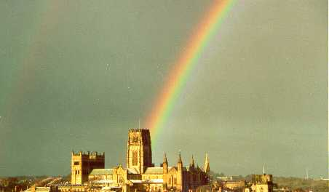

The cosmic dark matter
Carlos S. Frenk
Institute for Computational Cosmology, Durham

Slide 2
What is the Universe made of?
The (bizarre) contents of our Universe

Slide 3
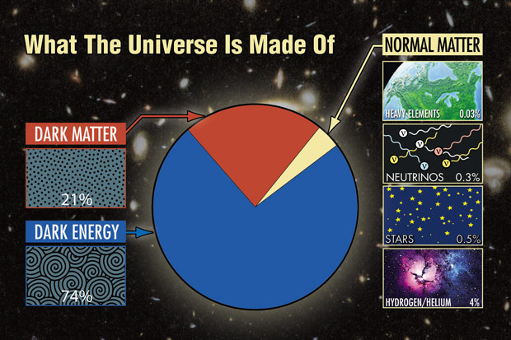
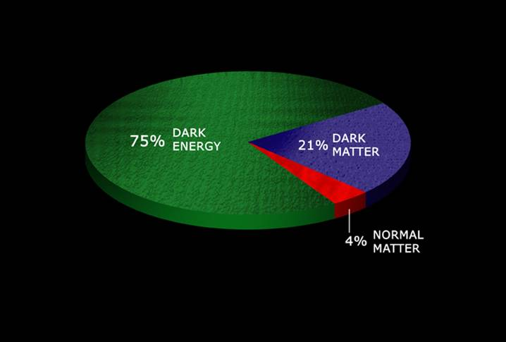
The content of our universe
5 %
Normal matter ≡ matter made of ordinary atoms

Slide 4
The content of our universe
25%
5 %
Dark matter ≡ matter that does not emit light at any wavelength

Slide 5

The content of our universe
70%
25%
5 %
Dark energy ≡ mysterious form of energy which opposes gravity

Slide 6
The content of our universe
70%
25%
5 %
Dark energy ≡ mysterious form of energy which opposes gravity and is causing the cosmic expansion to accelerate

Slide 7
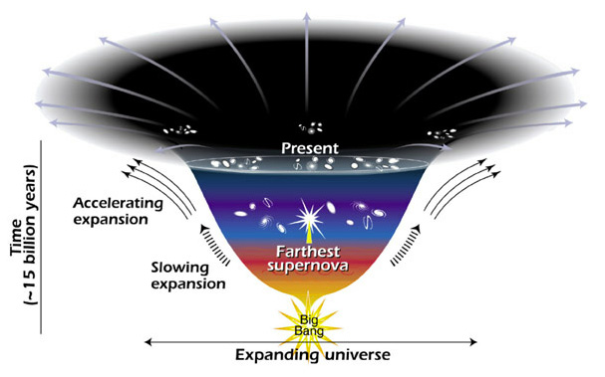
We know dark energy exists because
The expansion of the Universe is accelerating
2011 Nobel prize in physics!
➔ Universe full of dark energy

Slide 8
We can’t see the dark matter
How do we know it exists?

Slide 9
We know dark matter exists because
Stars in galaxies rotate too fast to be kept in place by gravity of the matter we can see
Galaxy images are distorted by dark matter

Slide 10
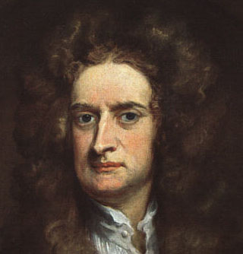
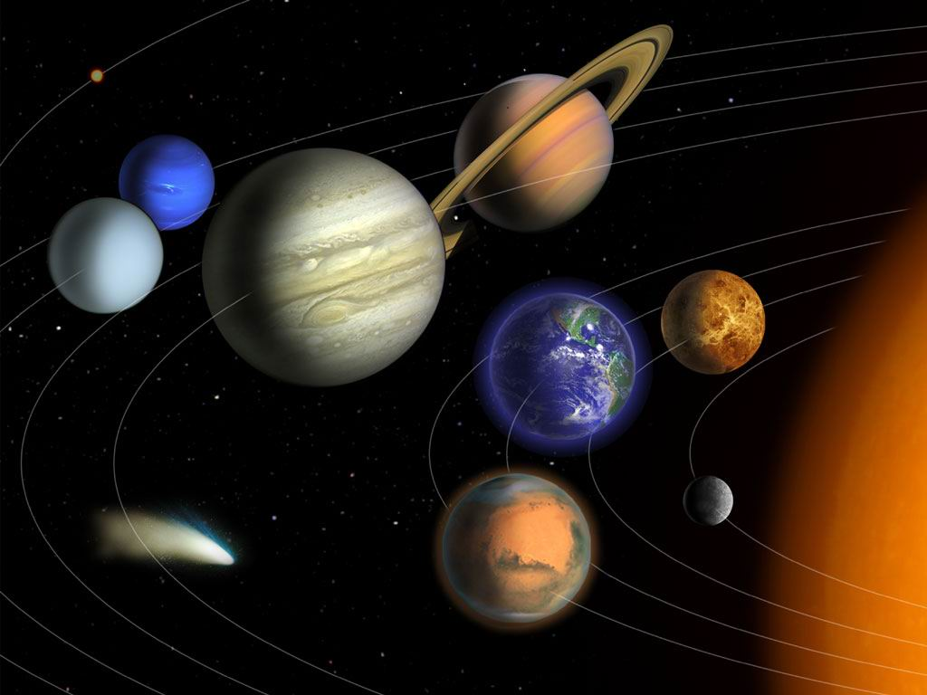
The force of gravity
Issac Newton:
matter → gravity → motion

Slide 11
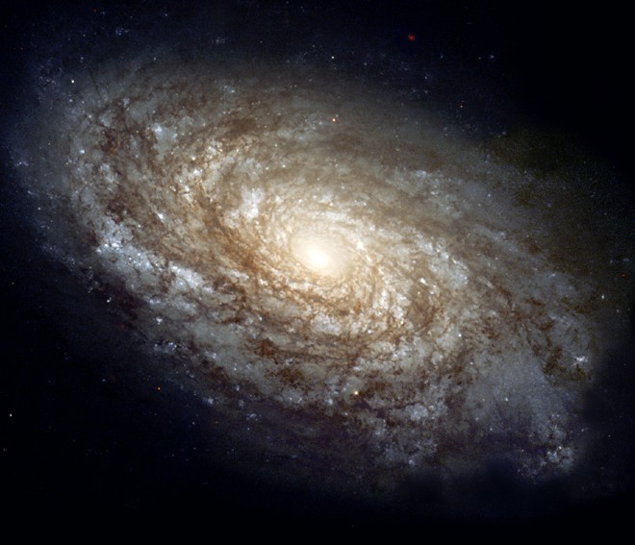
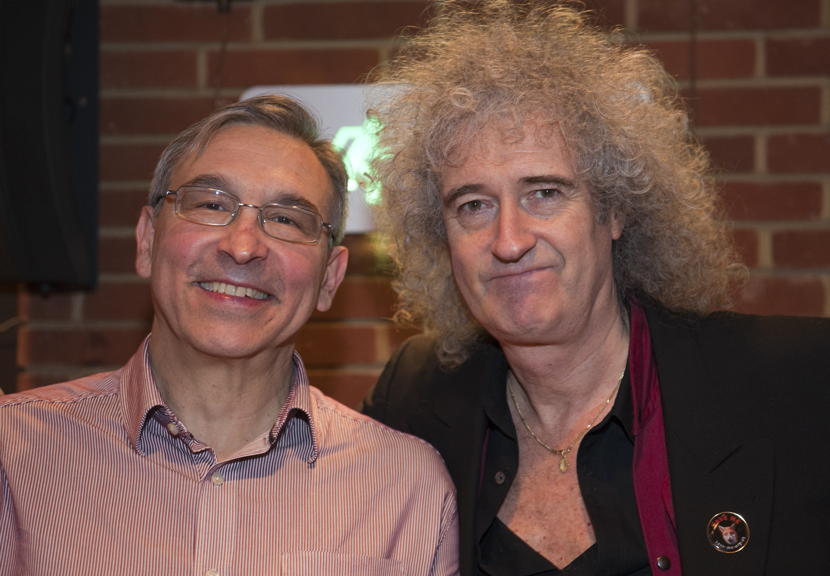
Stars rotate too fast to be held in place by gravity of visible mass

Slide 12
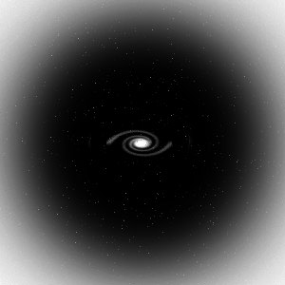
Clumps of dark matter: dark halos
→ dark matter keeps galaxy in place

Slide 13
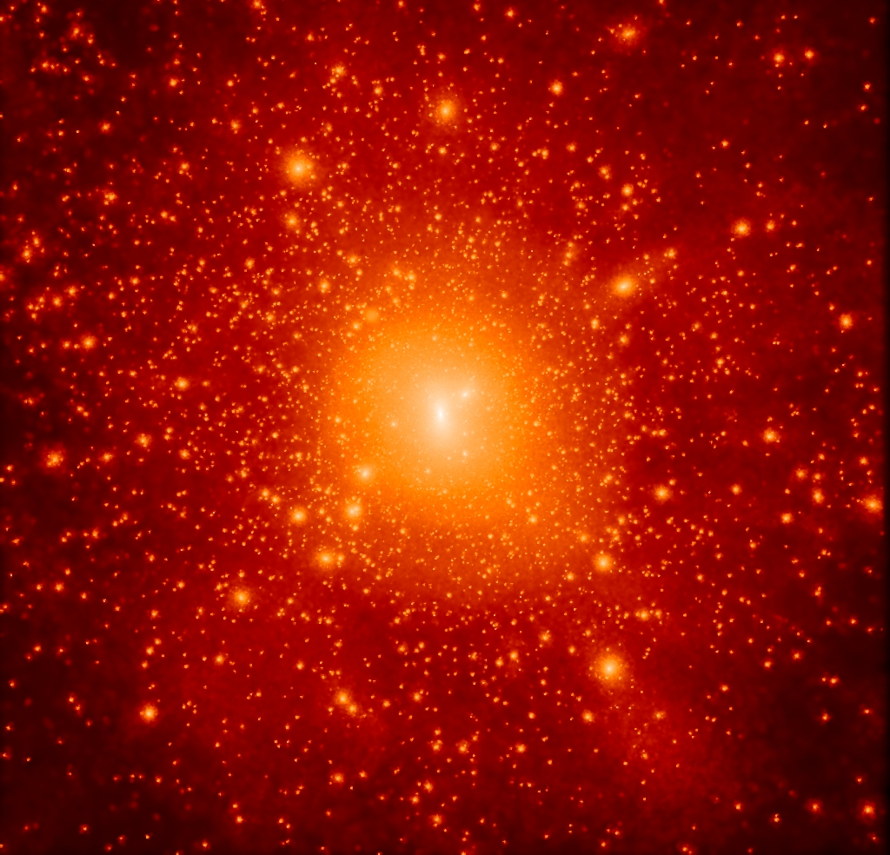
Galaxies are embedded in huge `halos’ of dark matter
Computer simulation of galaxy halo
0.5 Mpc/h

Slide 14
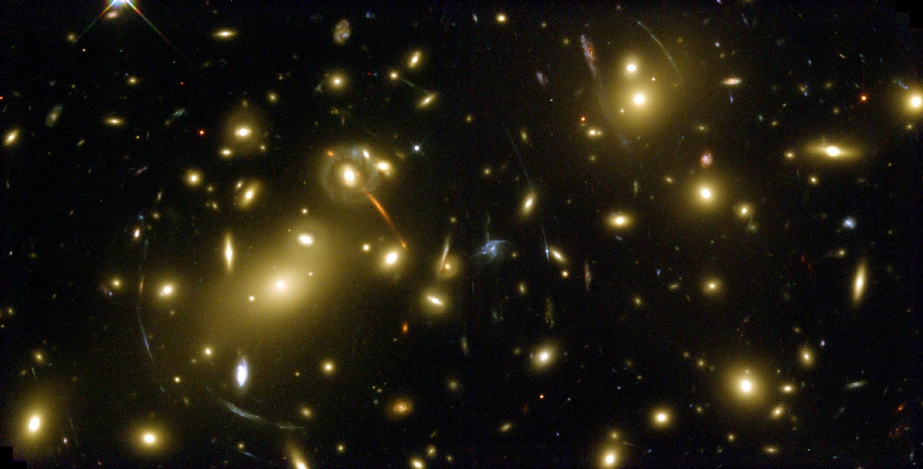
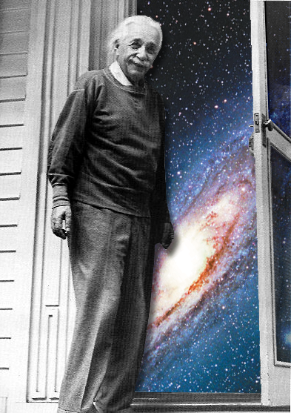
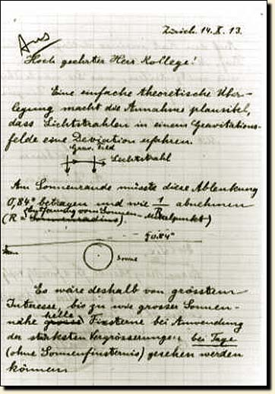
Gravitational lensing: mapping the dark matter
Light from distant galaxies is deflected by dark matter in cluster, distorting the galaxies’ images into arcs

Slide 15
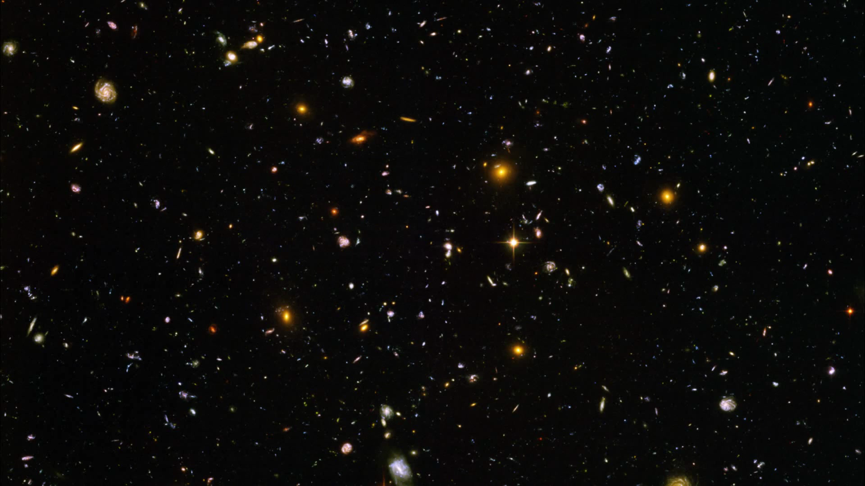

Slide 16
Gravitational lensing: Hubble space telescope
Gravitational lensing: Hubble space telescope
Can use gravitational lensing to “weigh” galaxy clusters → there is about 10 times more dark than visible mass
Light from distant galaxies is deflected by dark matter in cluster, distorting the galaxies’ images into arcs

Slide 17
What is the dark matter?

Slide 18
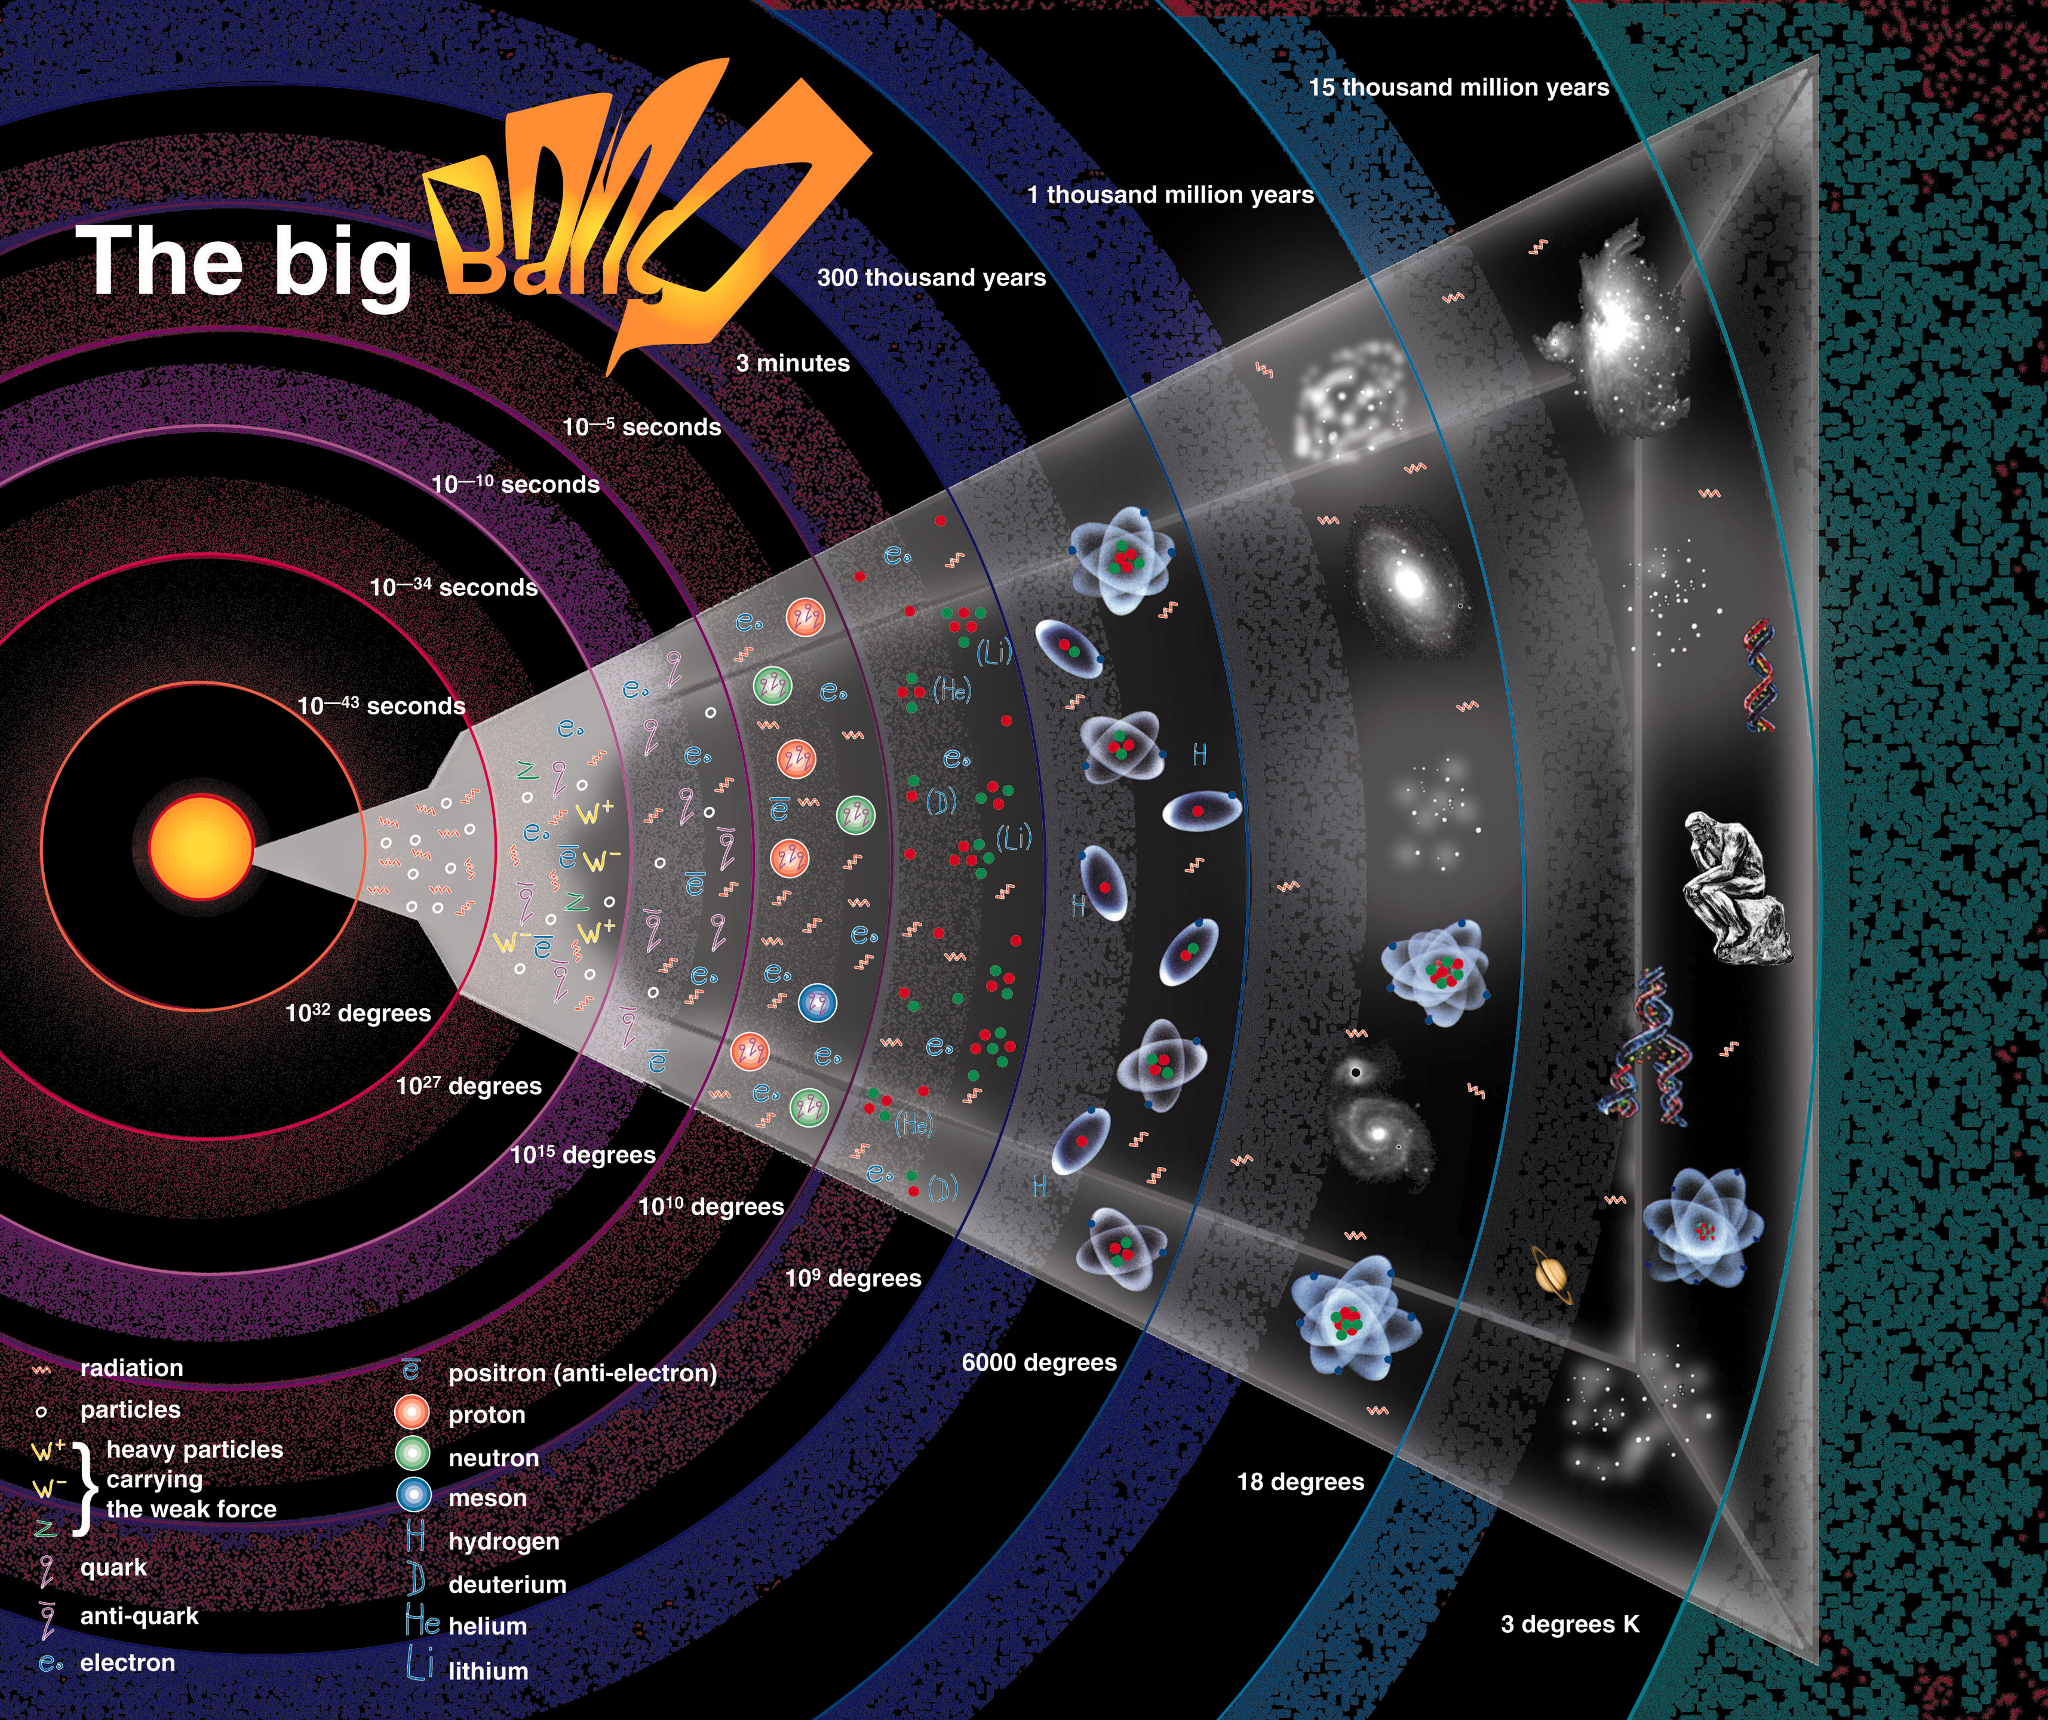
Dark matter
?
Elementary particles (Cold dark matter)
t = 13.7 billion yrs

Slide 19
The content of our universe
why is DM so important?
25%
5 %
Dark matter ≡ matter that does not emit light at any wavelength

Slide 20
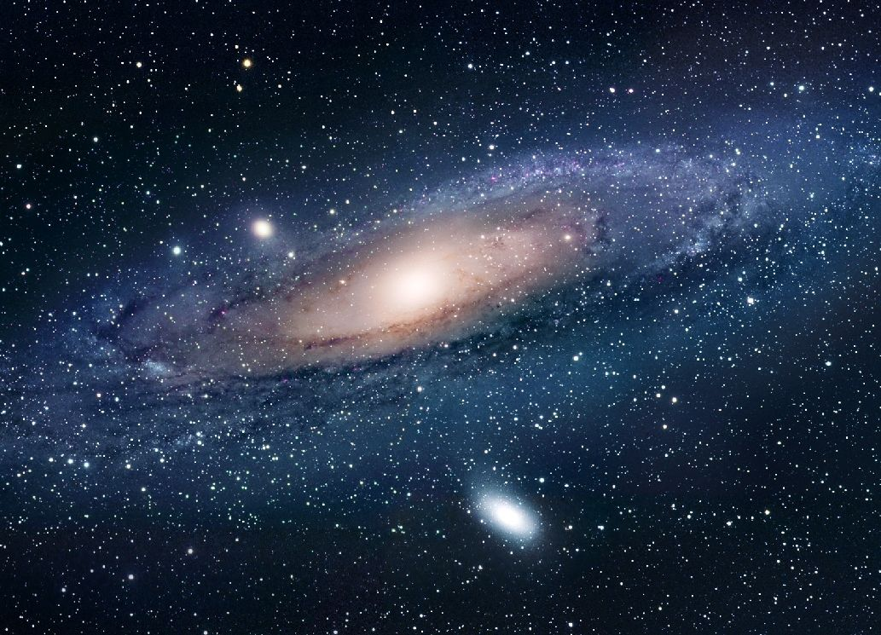
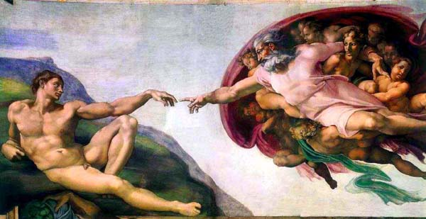
The gravity of the dark matter drives formation of cosmic structure
Where do the galaxies come from?

Slide 21
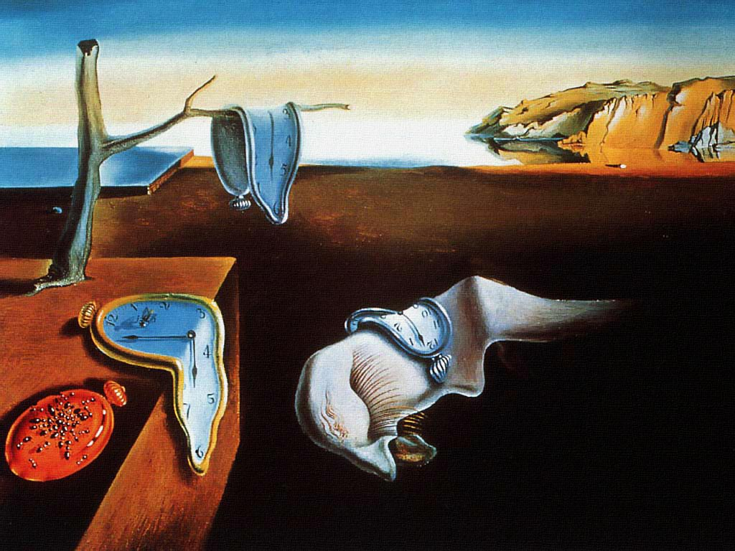
Production of dark matter
(t ~ 10⁻¹⁰ s)
Primoridal ripples amplified by gravity of dark matter
t = 13.7 billion yrs

Slide 22
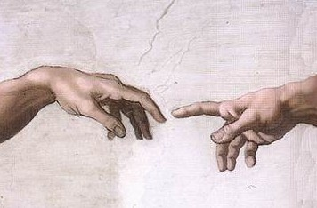
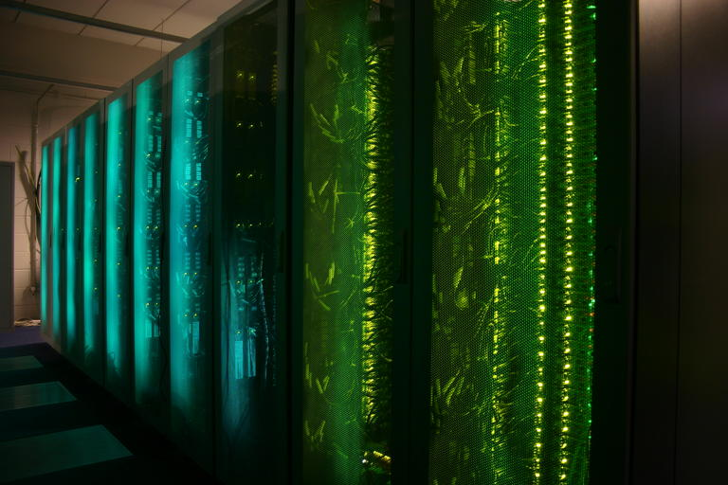
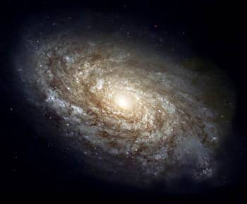
The formation of galaxies
Initial conditions
?

Slide 23
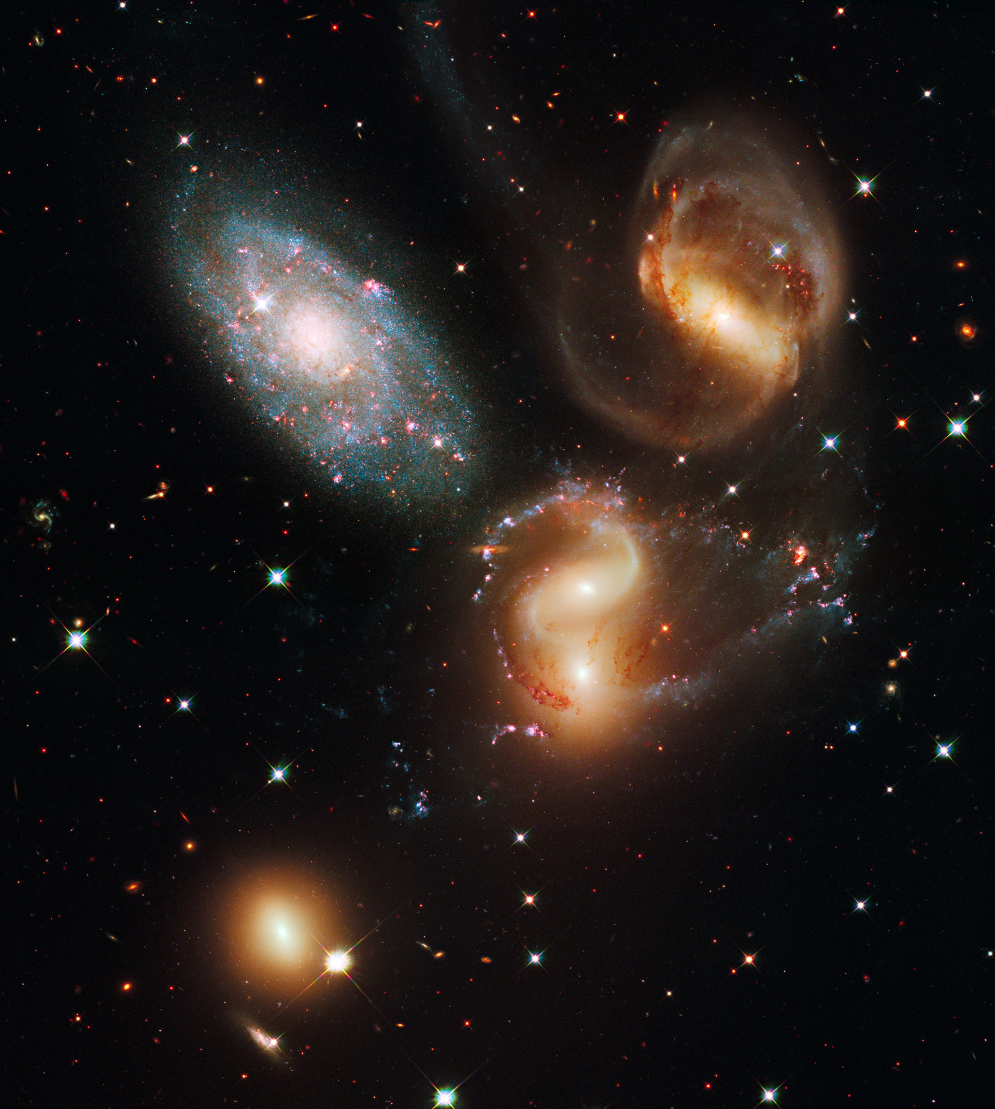
How to make a virtual universe
Initial conditions + assumption about content of Universe
Equations of physics: General Relativity Mechanics Radiative hydrodynamics
Atomic physics, etc

Slide 24
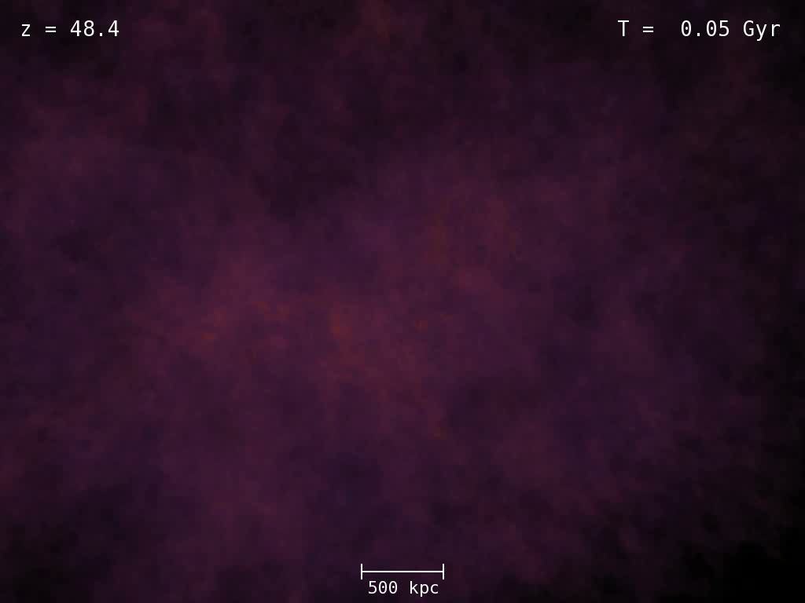

Slide 25
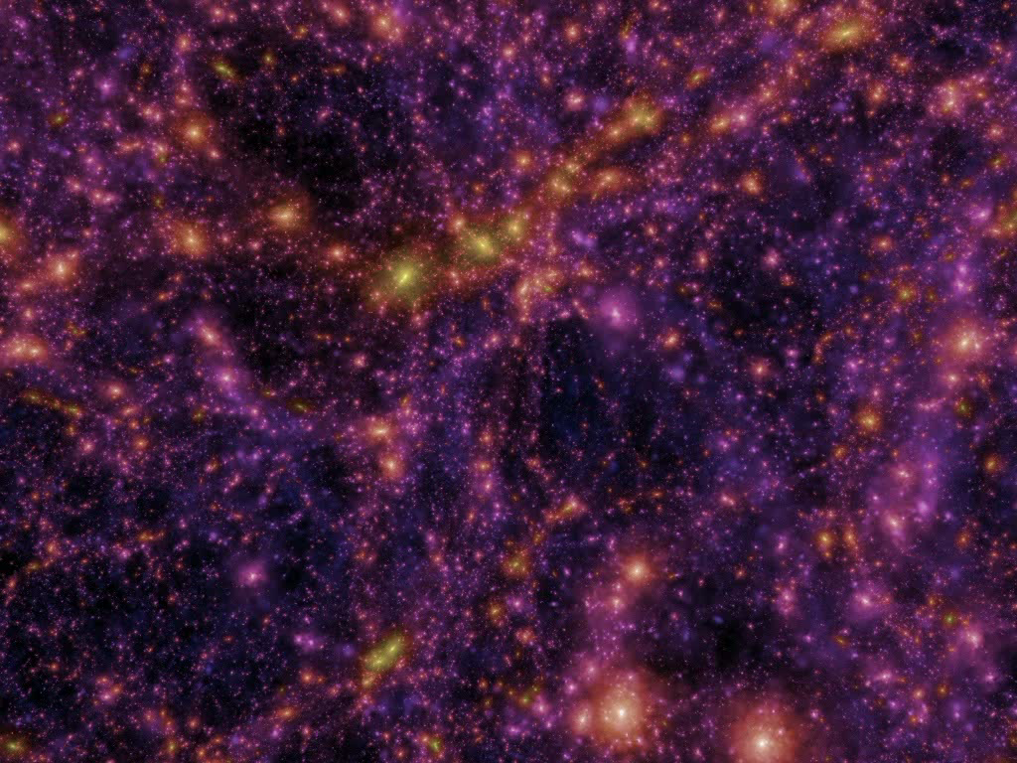

Slide 26
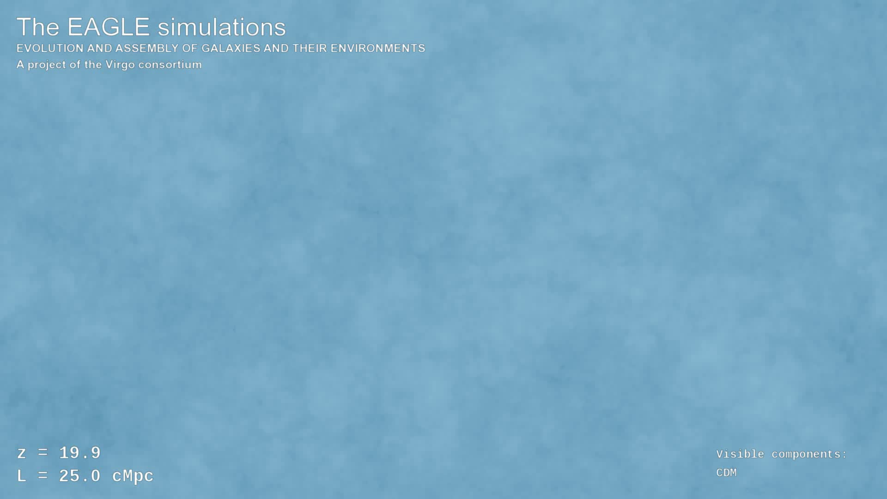

Slide 27
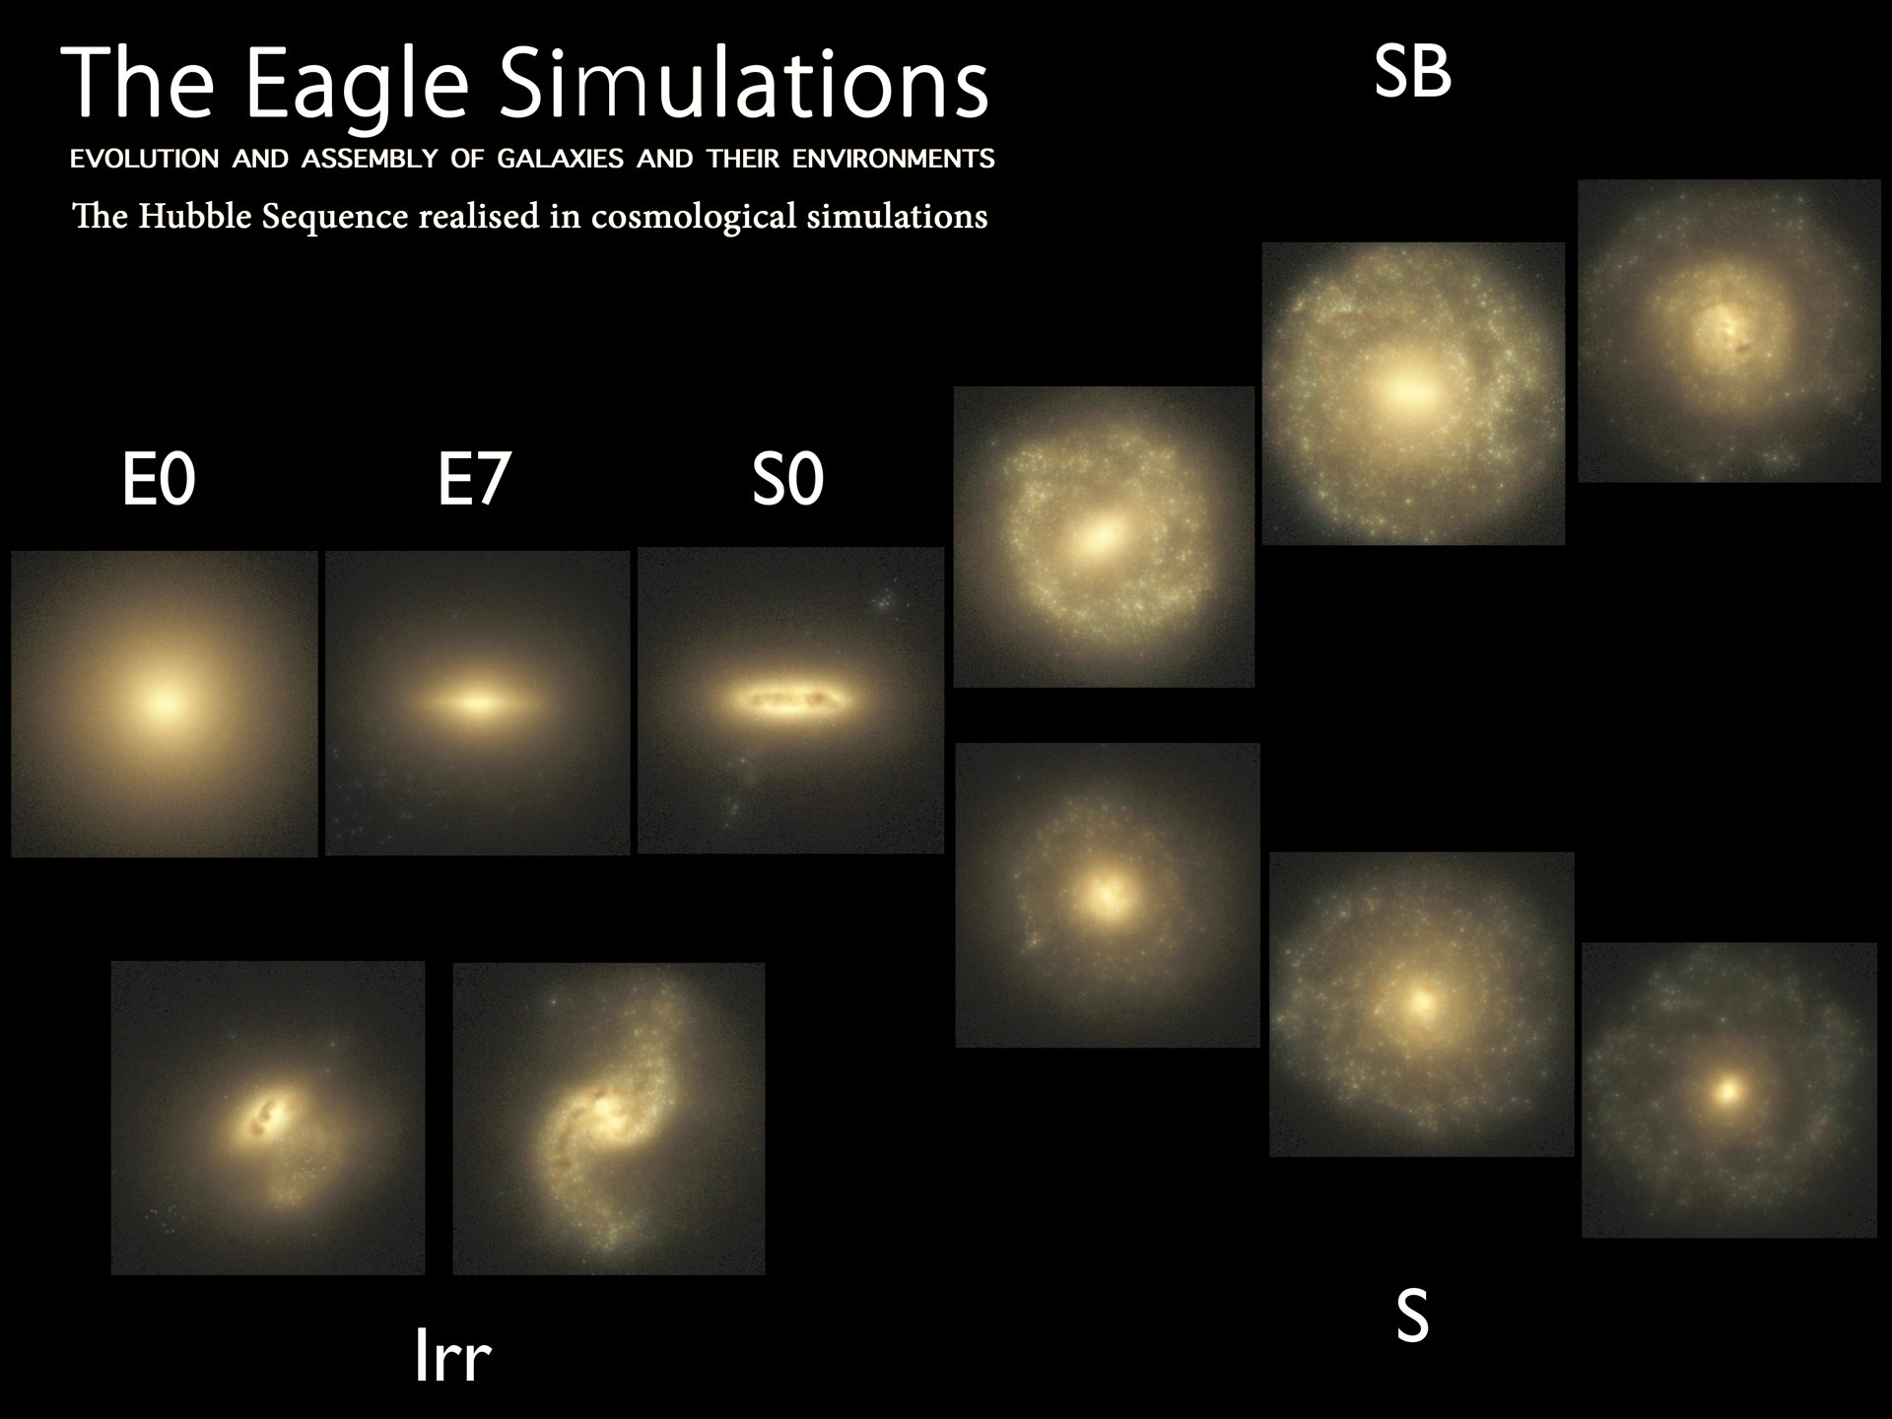
Trayford et al ‘15

Slide 28
What next?

Slide 29
The content of our universe

Slide 30
The search for dark matter
Experimental physics

Slide 31

The search for dark matter

Slide 32

Searching for the dark matter ?

Slide 33
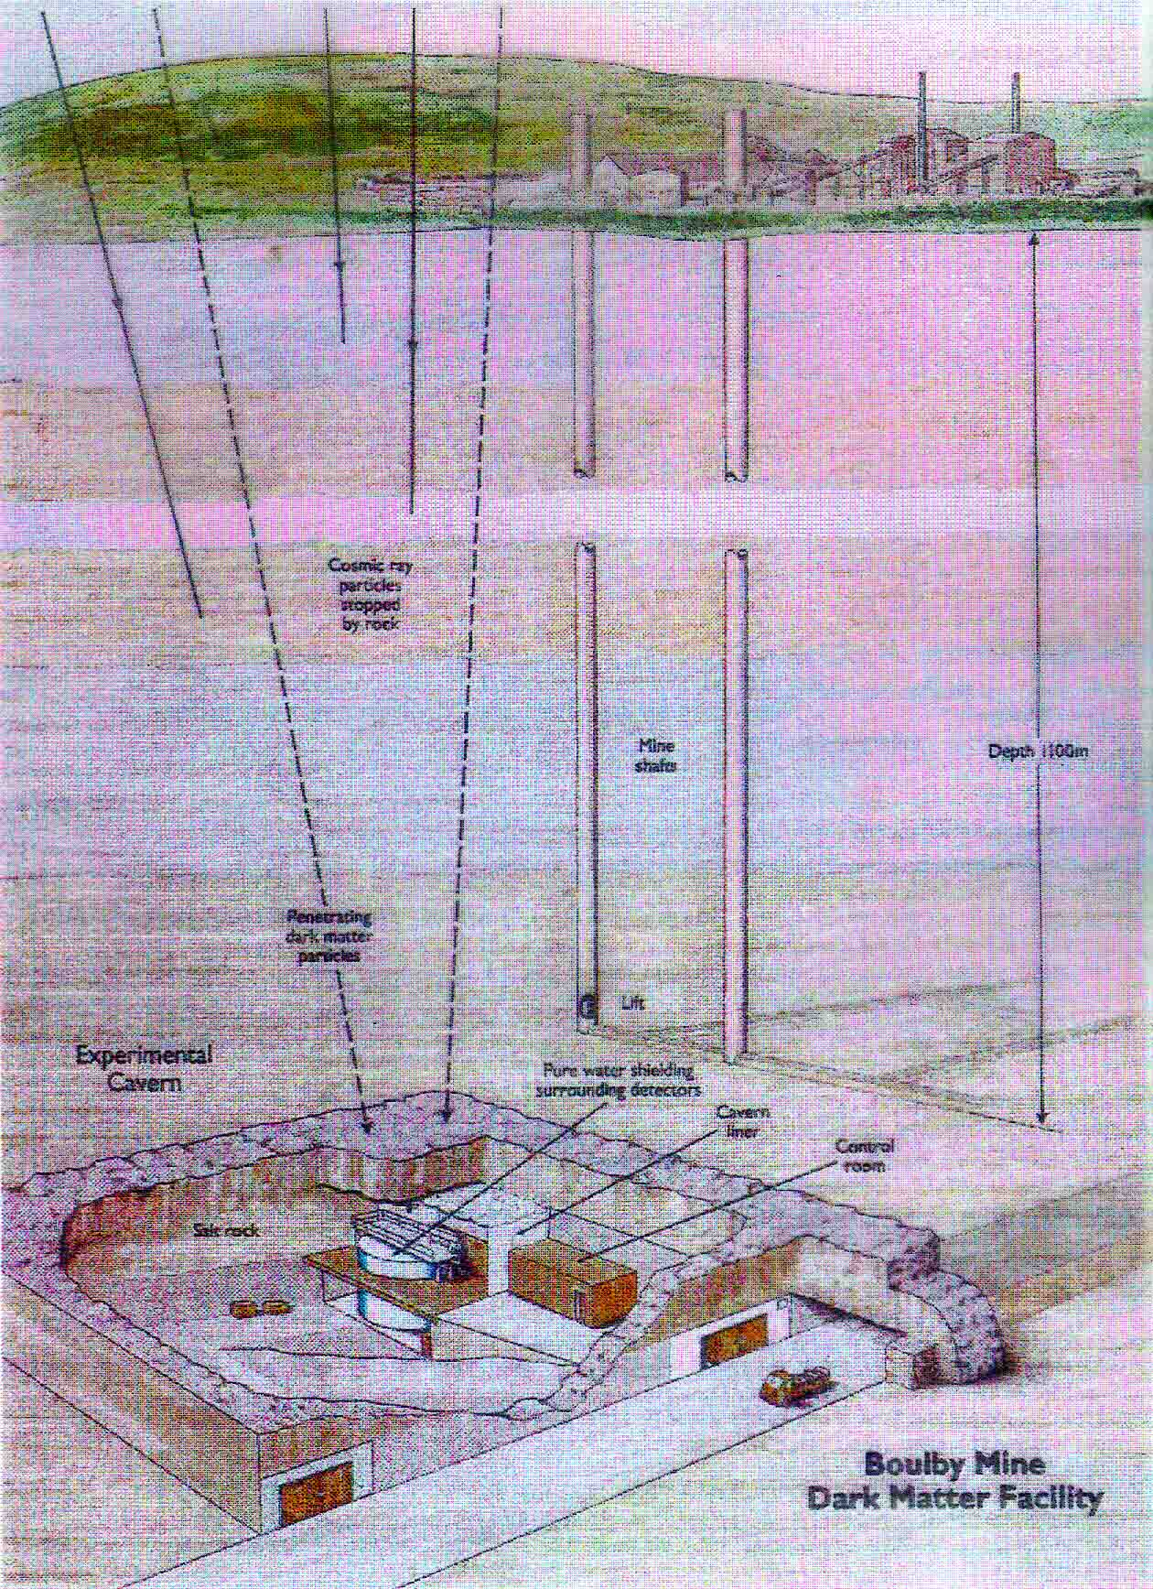

UK DM search (Boulby mine)
Boulby mine
Looking for dark matter … down the mine
(where cosmic rays can’t penetrate)

Slide 34
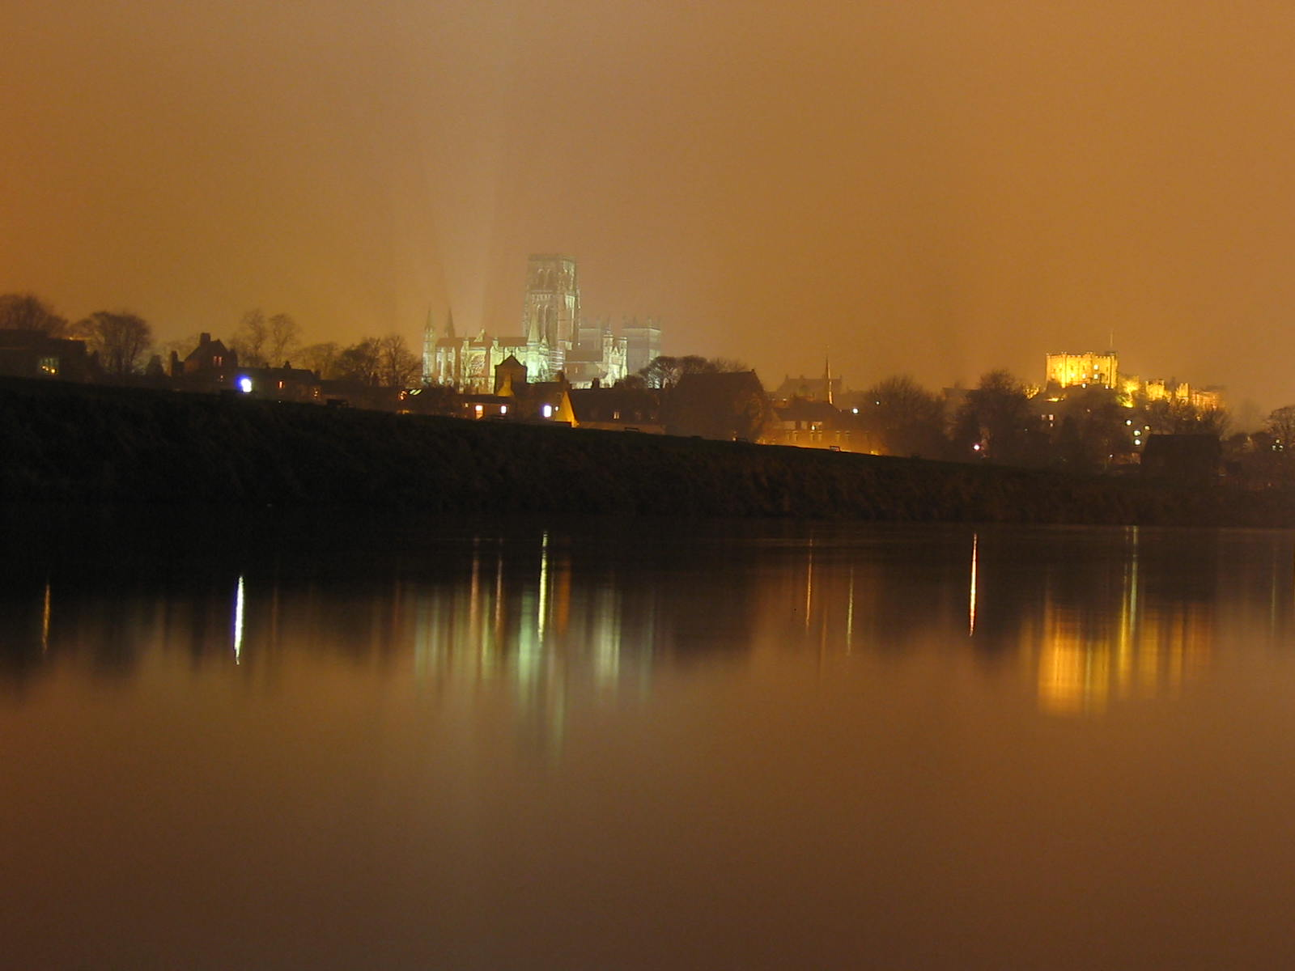
The dark matter is a key part of our universe that is responsible for the cosmic structure
… it should be discovered soon

