Slide 1
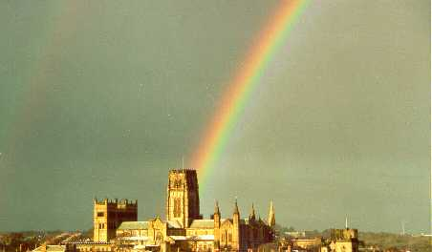

Computing the Universe
Carlos S. Frenk
Institute for Computational Cosmology, Durham

Slide 2
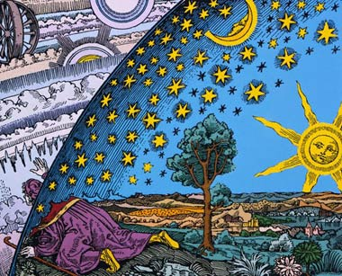
Humans are naturally curious about their origin and their environment
Flammarion 1888: tete des etoiles

Slide 3
There is no greater origin than the origin of our Universe
And there is no greater environment than the Universe itself
Flammarion 1888: tete des etoiles

Slide 4
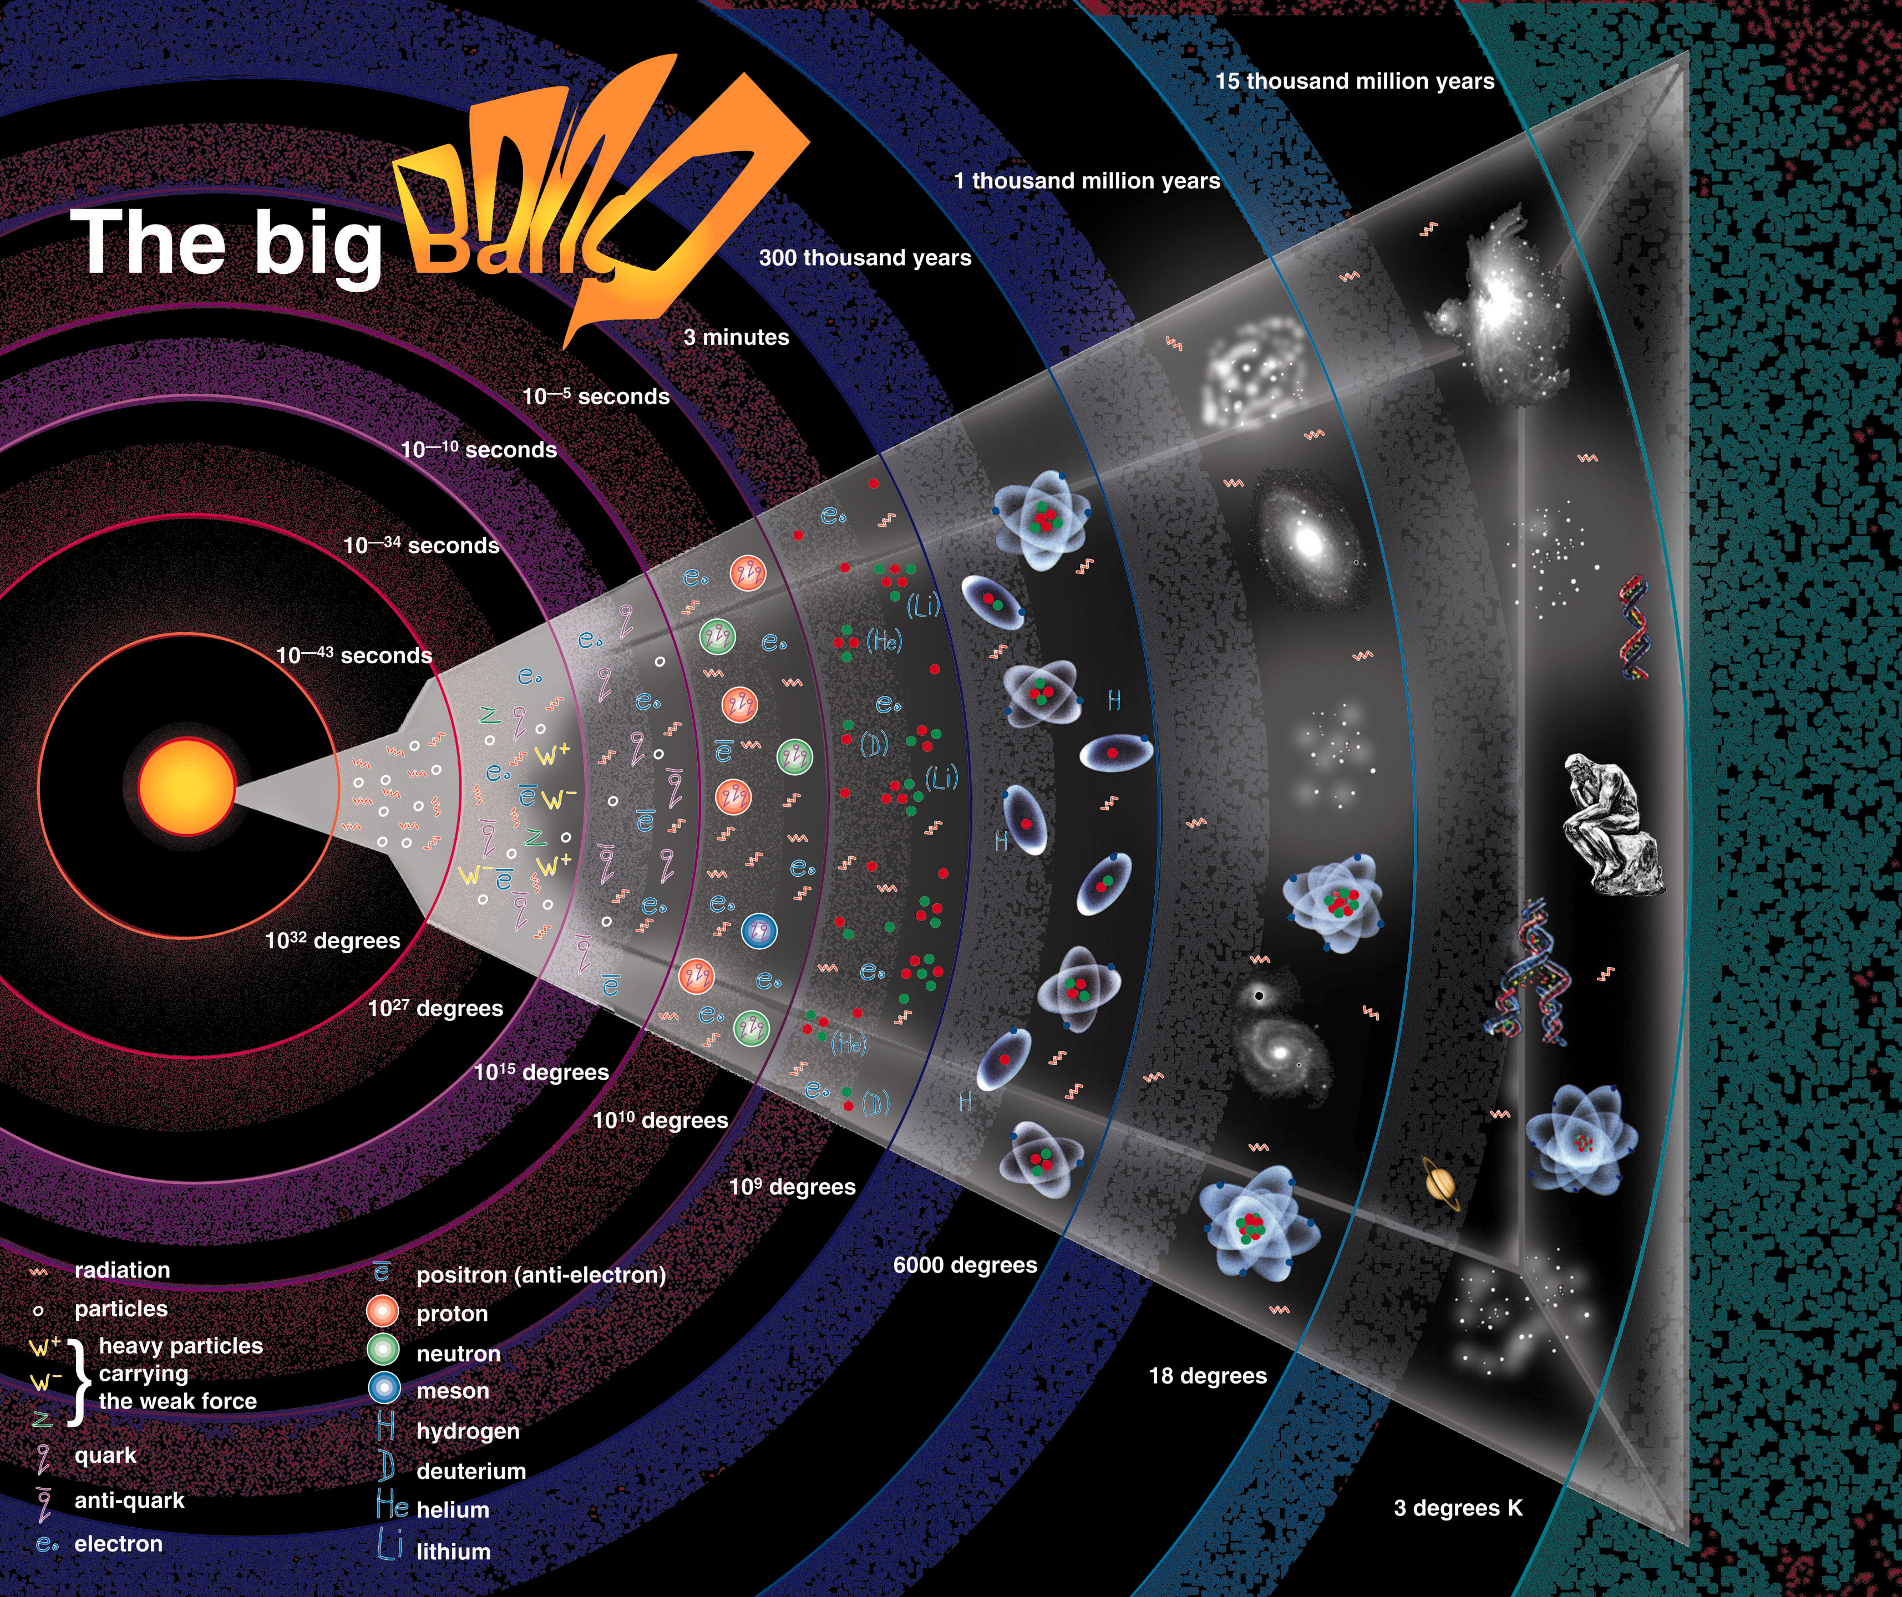
We know much about the history of our Universe, from the Big Bang to the present day
t = 13.7 billion yrs

Slide 5
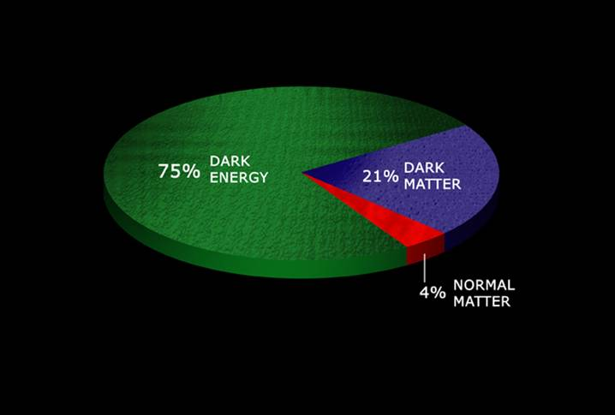
The content of our universe
70%
25%
5 %
Only 5% of the Universe content is ordinary matter

Slide 6
The content of our universe
70%
25%
5 %
25% is dark matter – does not emit light of any kind

Slide 7
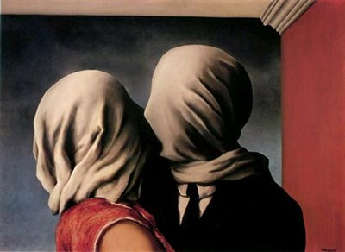
The content of our universe
70%
25%
5 %
Dark energy ≡ mysterious form of energy which opposes gravity and is causing the cosmic expansion to accelerarte

Slide 8
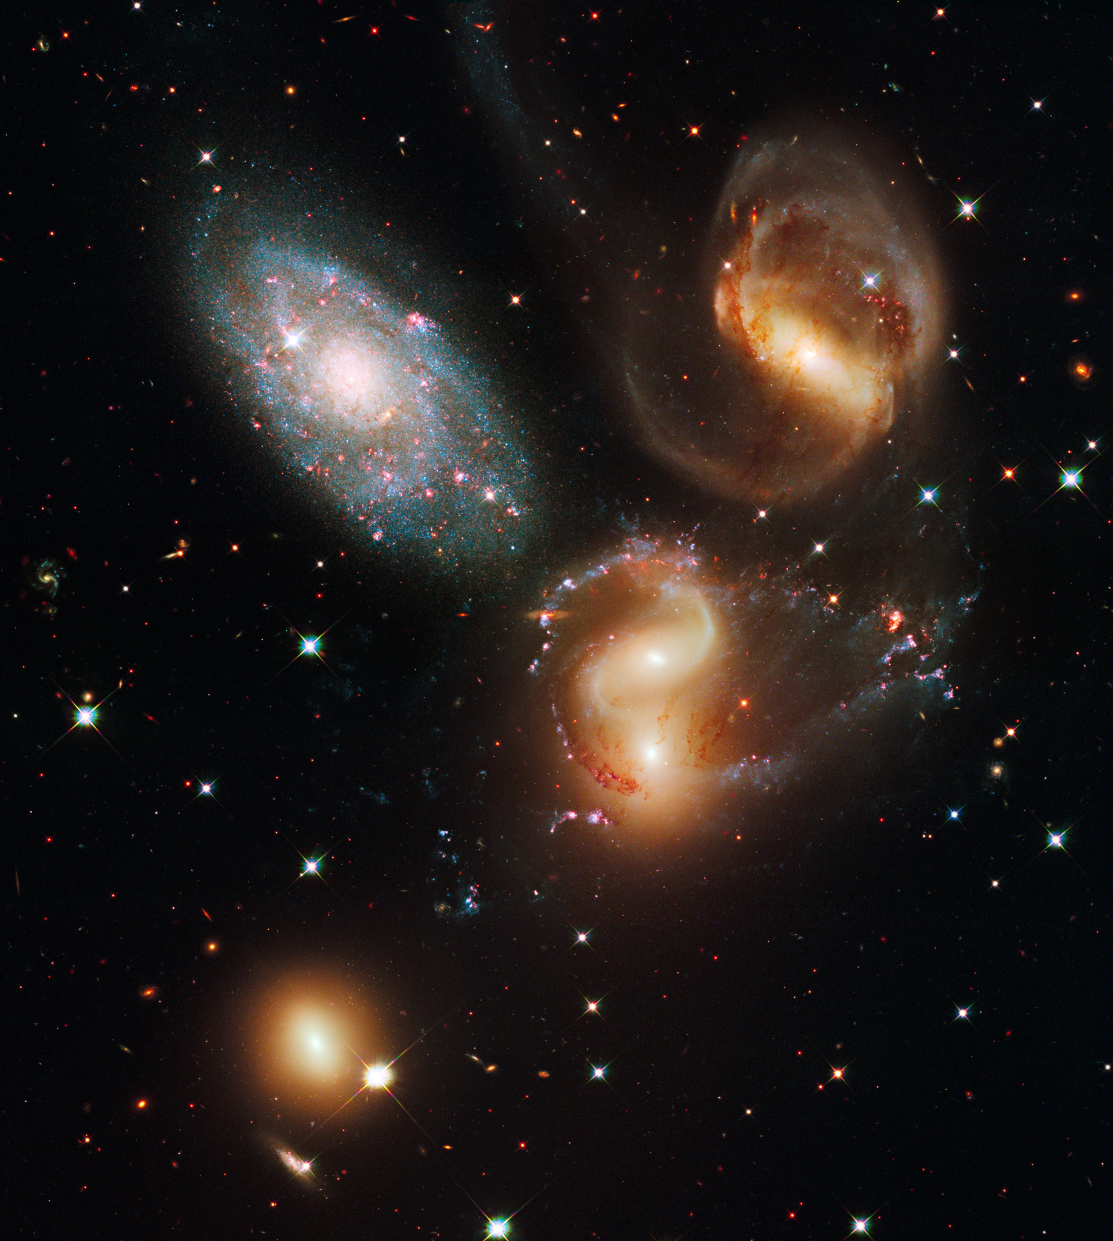
We know how galaxies formed

Slide 9
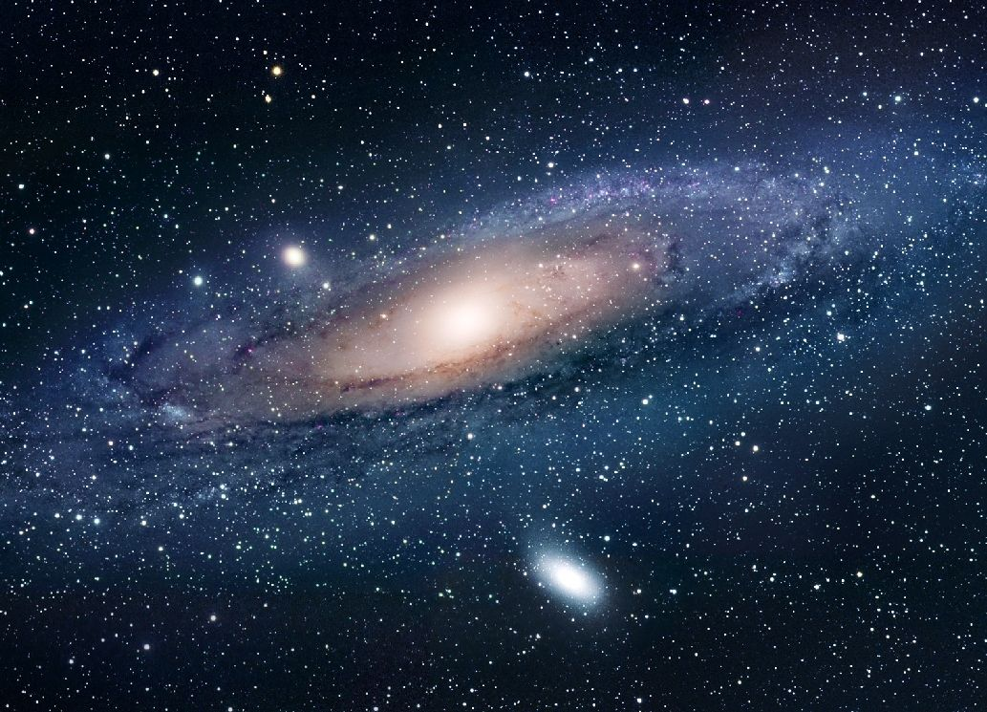
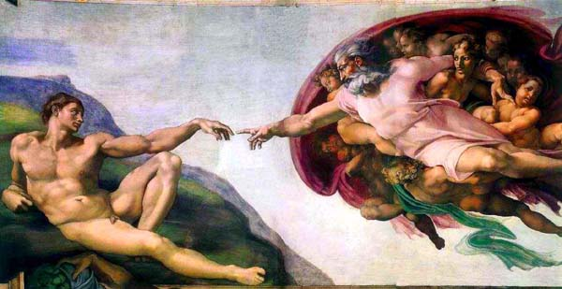
Where do the galaxies come from?

Slide 10
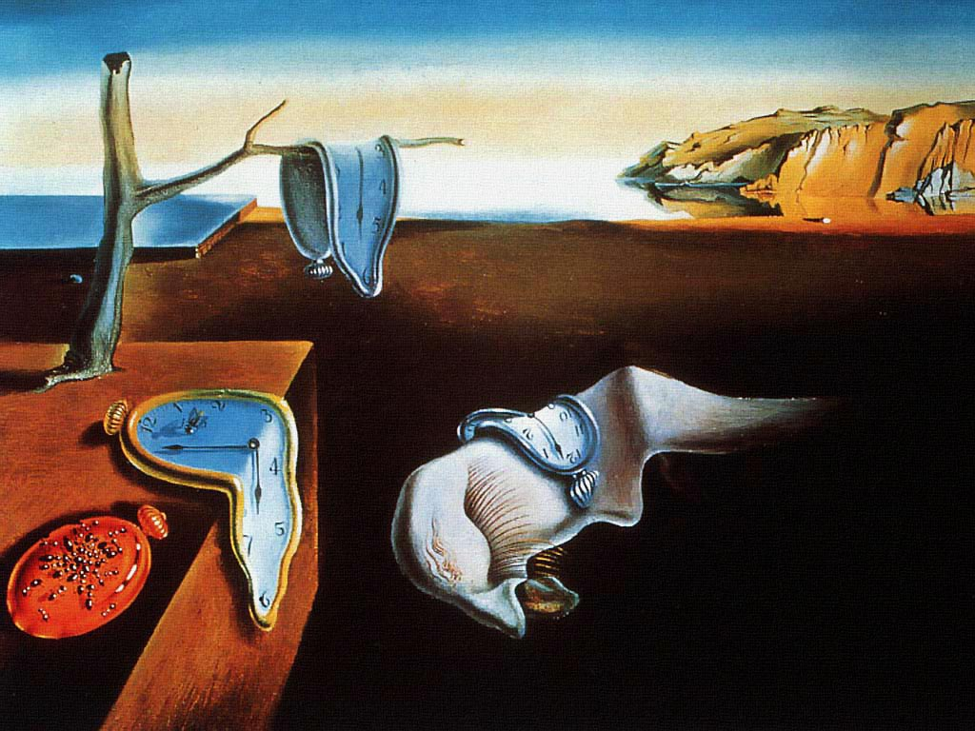
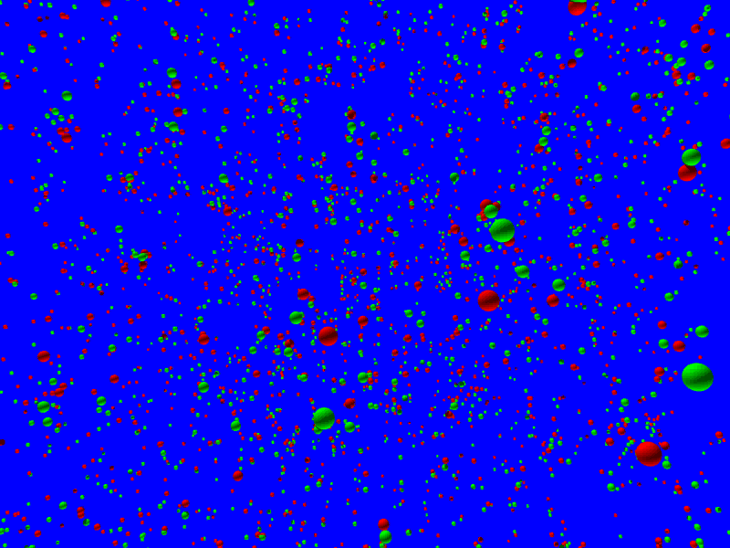
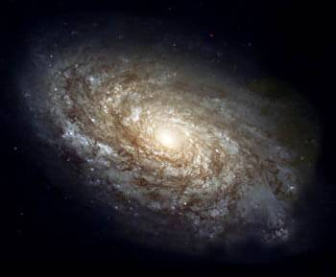
t=0.00000000000000000000000000000000001 sec
Production of dark matter
(t ~ 10⁻¹⁰ s)
Primoridal ripples amplified by gravity of dark matter
t = 13.7 billion yrs
Cosmic inflation → Quantum fluctuations (t ~ 10⁻³⁵ s)
Initial conditions

Slide 11
HOW do we know all this?
All we can see is light (at different wavelengths)*
*And since last year gravitational waves too
Flammarion 1888: tete des etoiles

Slide 12
HOW do we know all this?
And light travels at a fixed speed (300,000 km/s)
We don’t see things as they are, but as they were when their light was emitted
Asronomers can see the past !
Flammarion 1888: tete des etoiles

Slide 13
We see galaxies around us
A hundred billion stars
100,000 ly
Nearest bright galaxy: Andromeda (about 2 billion light years away)

Slide 14
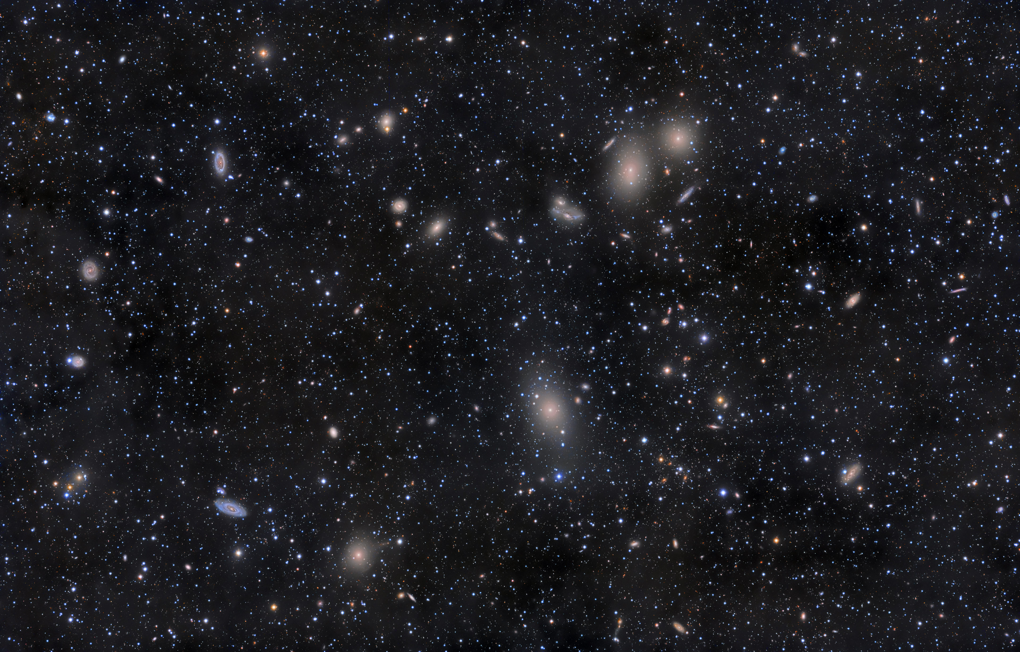
And clusters of galaxies
Thousands of galaxies, each with a hundred billion stars
Nearest large cluster: Virgo (about 65 million light years away)

Slide 15
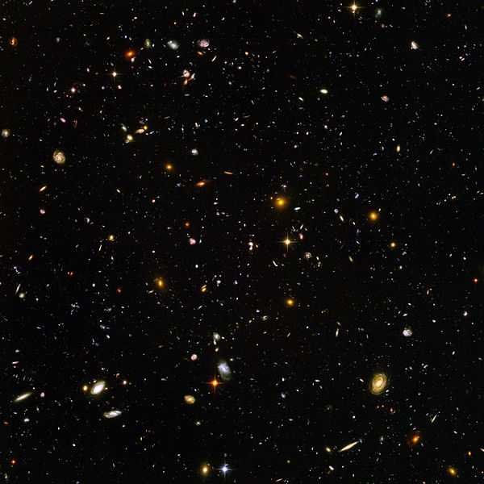
And very distance galaxies
The “visible” universe contains about 100 billion galaxies (each with about 100 billion stars)
The Hubble ultra-deep field
Very distant galaxies (about 21 billion light years away)

Slide 16
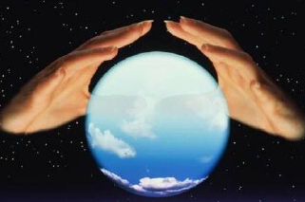
The cosmic microwave background is emitted
(t ~350,000 yrs)
t=0.00000000000000000000000000000000001 sec
Production of dark matter
(t ~ 10⁻¹⁰ s)
The first light in our Universe
t = 13.7 billion yrs
Cosmic inflation → Quantum fluctuations (t ~ 10⁻³⁵ s)
Initial conditions

Slide 17
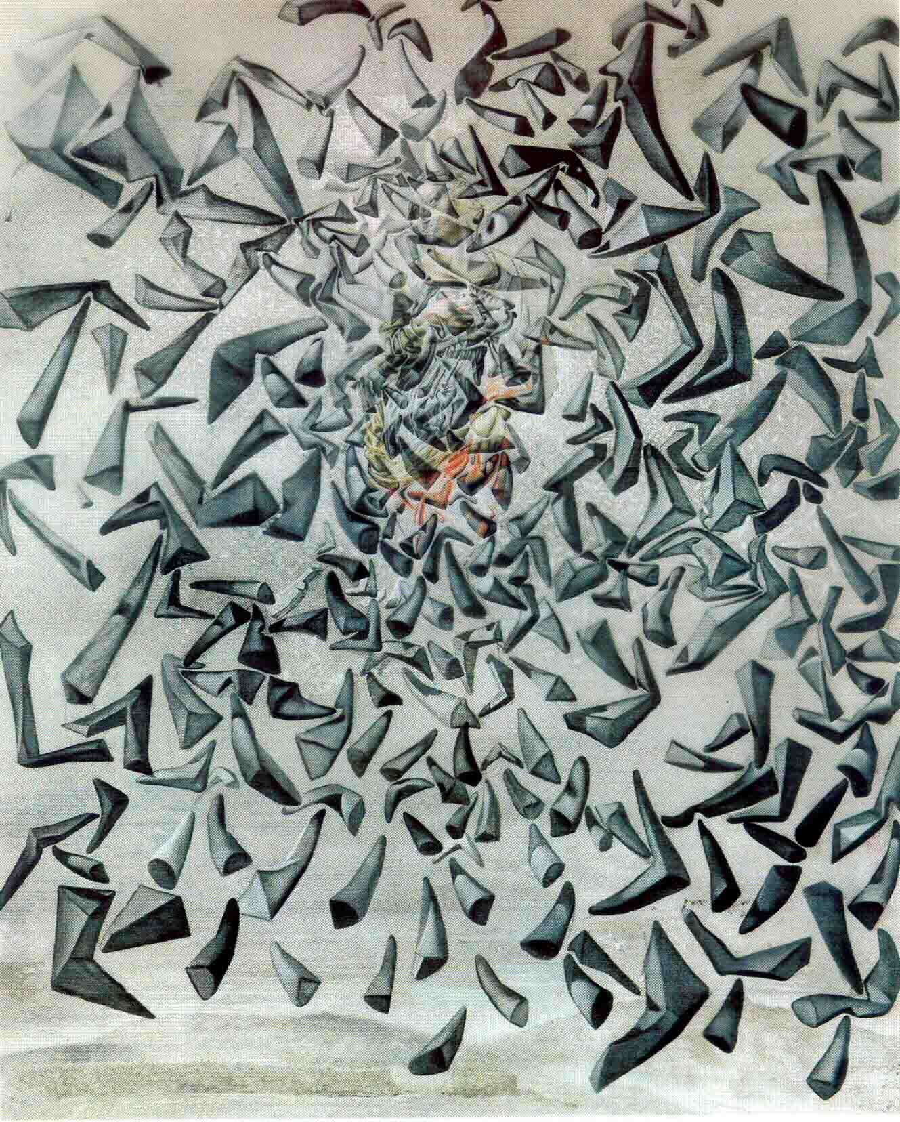
The heat from the Big Bang
By today, the radiation from the Big Bang has cooled to 2.7 degrees

Slide 18
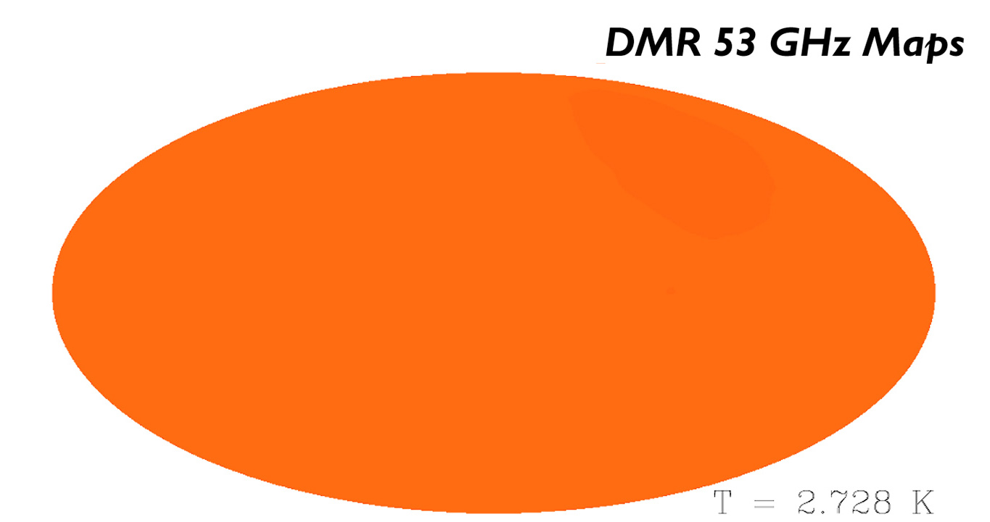
We receive radiation from an epoch before galaxies formed
The cosmic microwave background (emitted when the Universe was 370 000 years old)

Slide 19
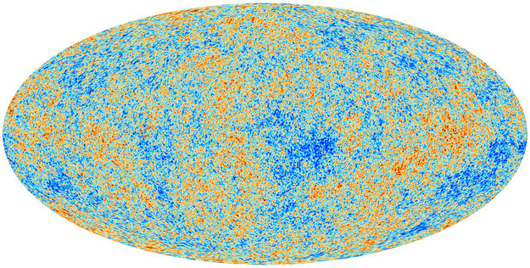
The initial conditions for galaxy formation
We can detect radiation emitted before galaxies formed!
Quantum fluctuations from inflation
When Universe was the human equivalent of a few hours old!

Slide 20
How do we work all this out?
t = 13.7 billion yrs

Slide 21
The science of the Universe
Modern cosmology is based on:
The laws of Physics: general rules about natural phenomena, derived empirically and expressed mathematically, e.g. Newton’s law of gravitation, Boyle’s gas law, quantum mechanics, relativity
  Experimentally verified on Earth
  Universal (?)

Slide 22
The traditional scientific method
Experiment
Theory
But in cosmology we cannot perform experiments

Slide 23
The traditional scientific method
Observation
Theory
And observations only provide snapshots in time

Slide 24
The modern scientific method in cosmology
Observation
Theory
Computer simulation

Slide 25
How did galaxies form?

Slide 26
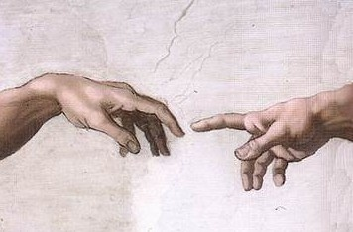
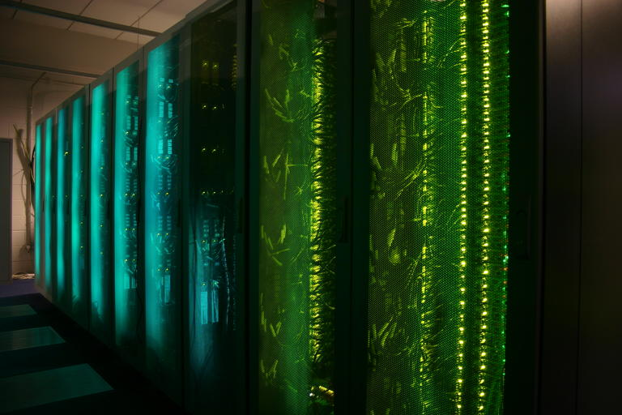
The formation of galaxies
Initial conditions
?

Slide 27
How to make a virtual universe
Initial conditions + assumption about content of Universe
Equations of physics: General Relativity Mechanics Radiative hydrodynamics
Atomic physics, etc

Slide 28
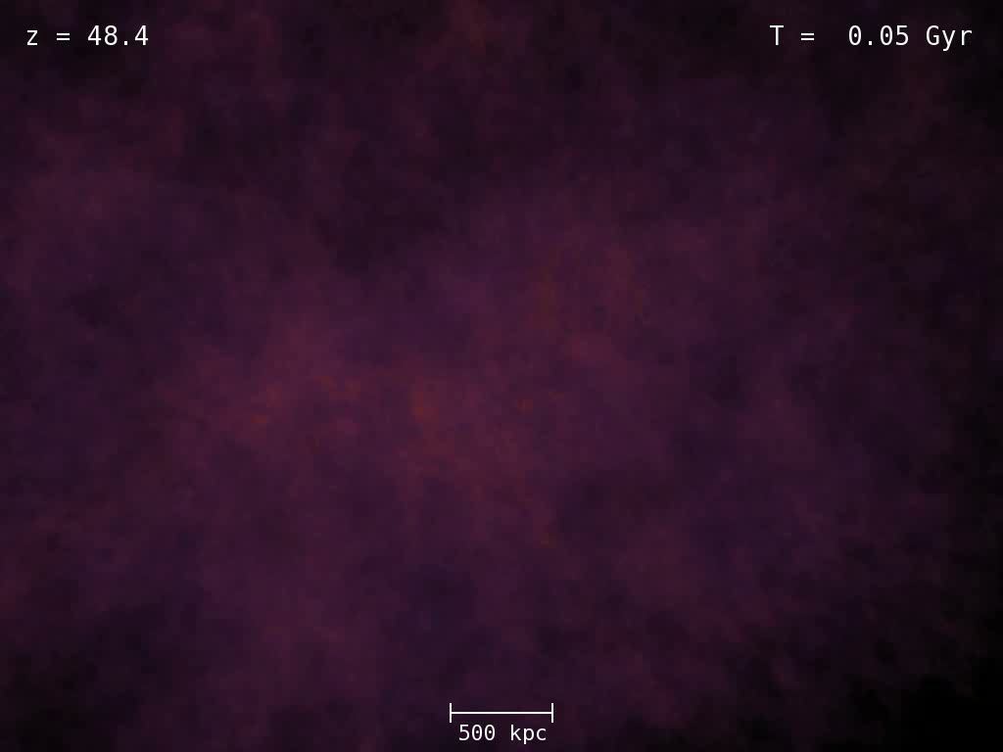

Slide 29
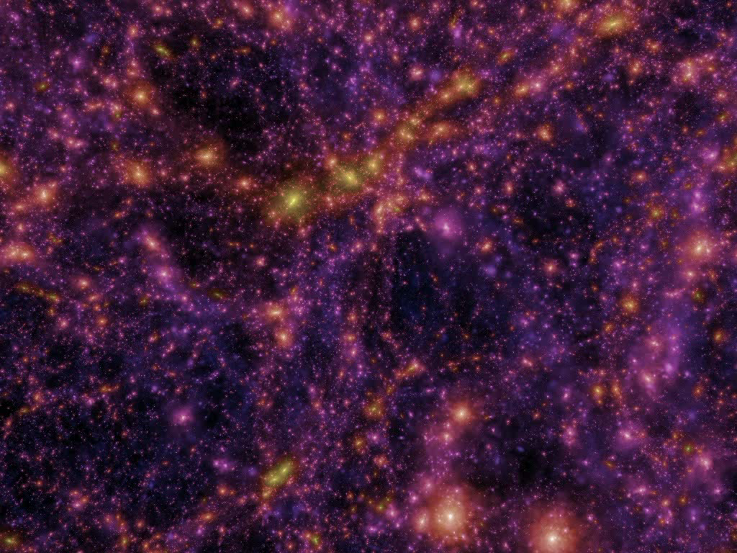

Slide 30
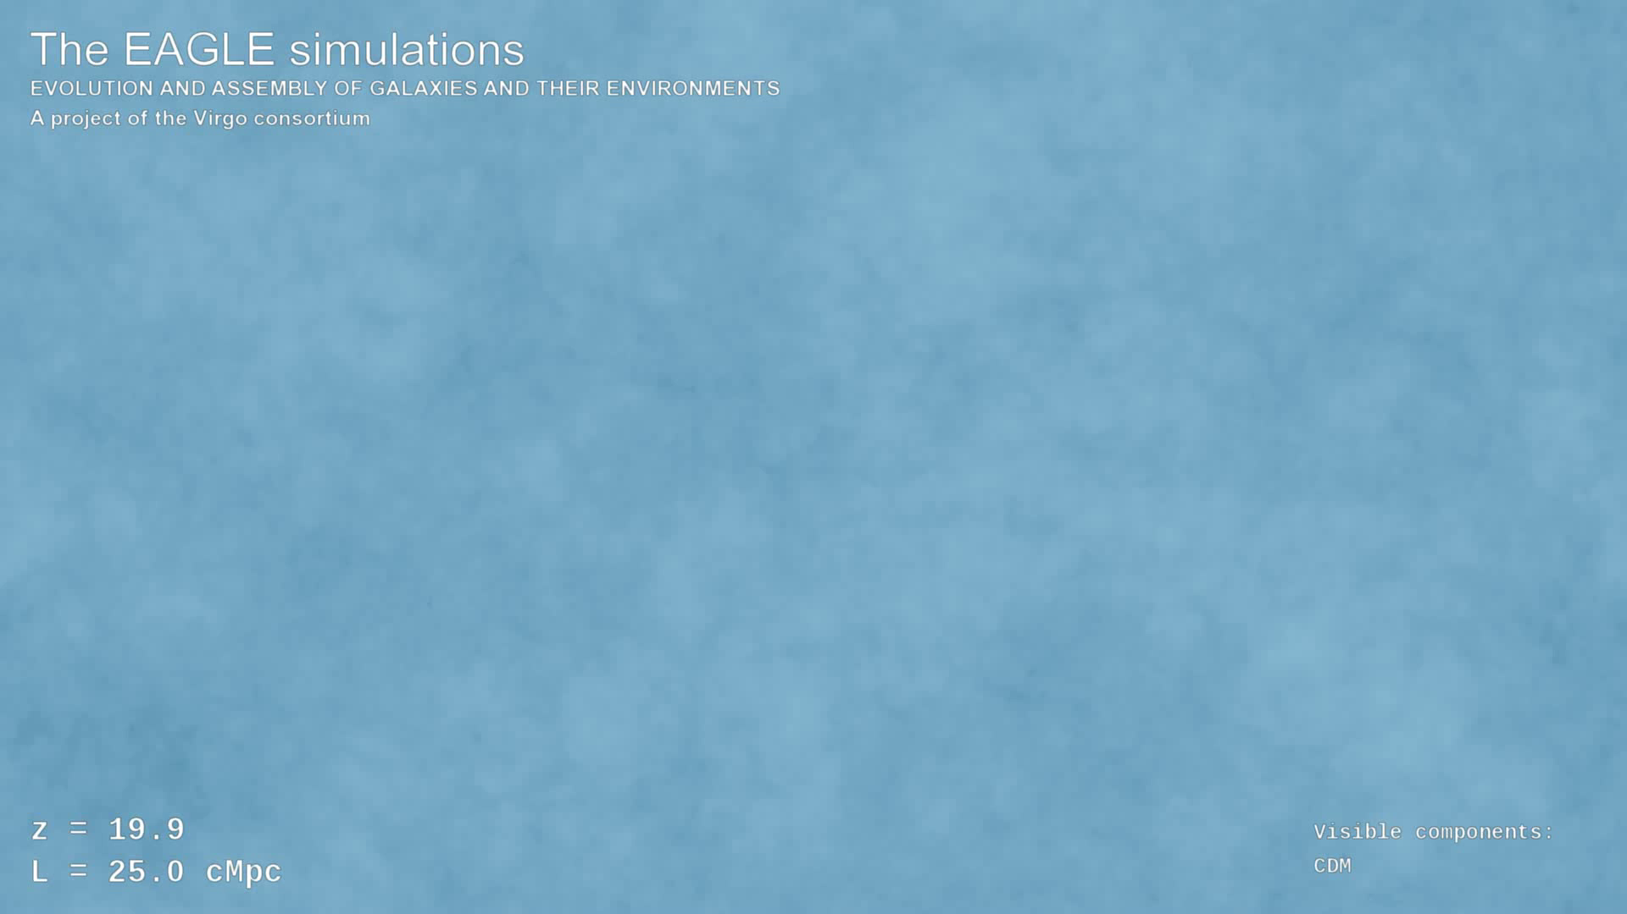

Slide 31
60 years of supercomputer simulations
From 20 particles in 1960 to 10¹¹ in 2010

Slide 32
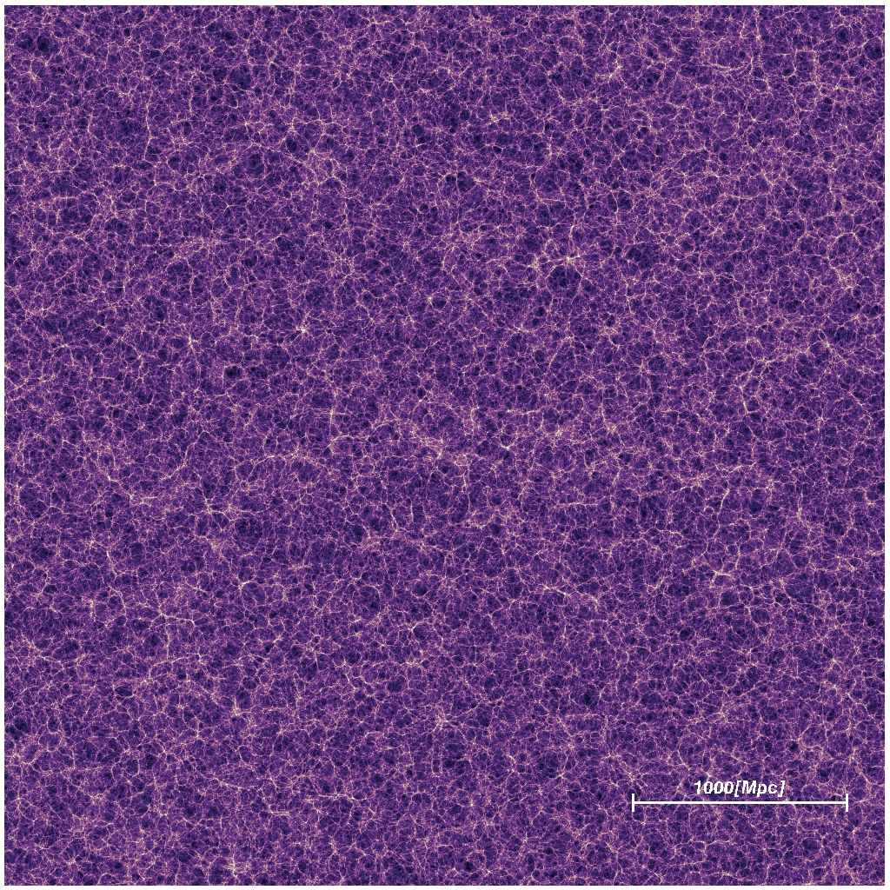
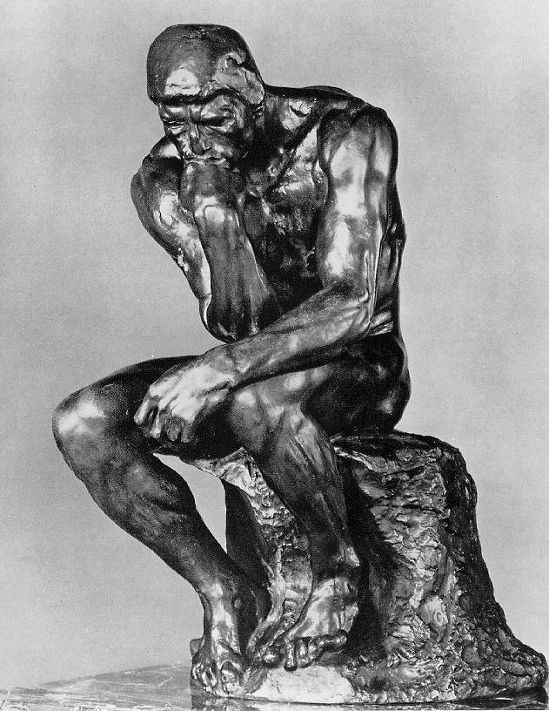
Theory, computing and modelling

Slide 33
Today: make stars and galaxies in a computer from quantum fluctuations at the Big Bang
Flammarion 1888: tete des etoiles

Slide 34
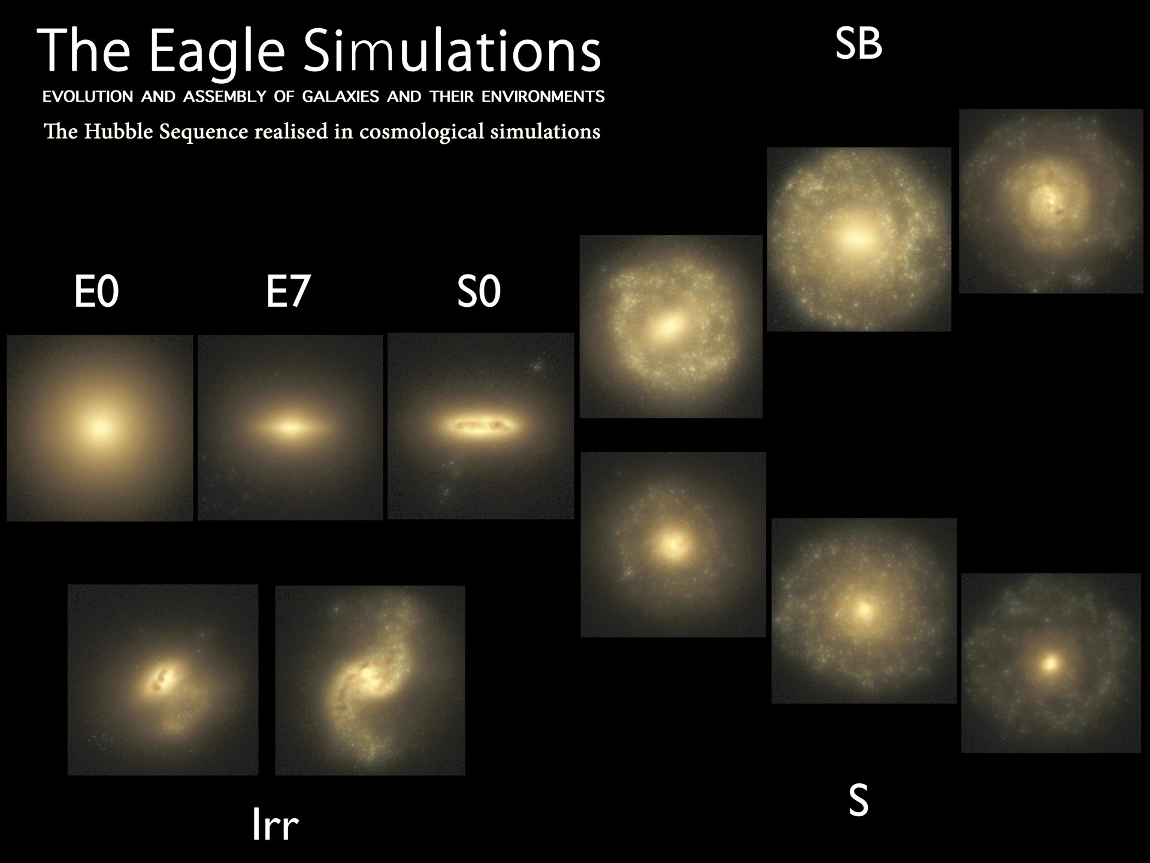
Trayford et al ‘15

Slide 35
Today: make stars and galaxies in a computer from quantum fluctuations at the Big Bang
Tomorrow:
Planets?
Life?
Consciousness?
Flammarion 1888: tete des etoiles

