Slide 1

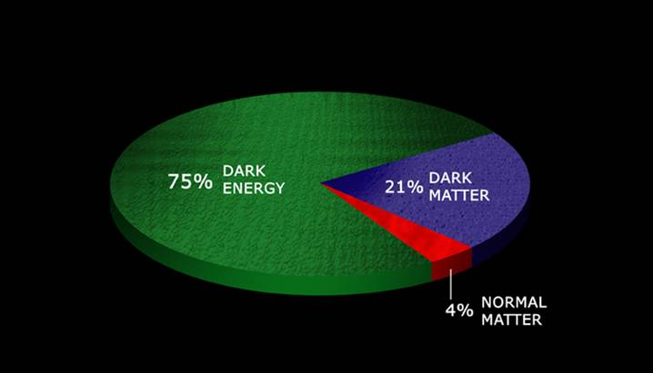
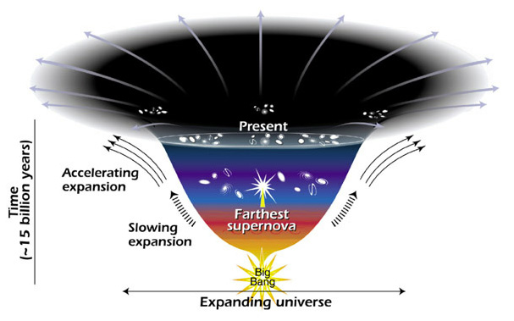
The content of our universe
70%
25%
5 %
Dark energy ≡ mysterious form of energy that opposes gravity and is causing the cosmic expansion to accelerate
Dark matter ≡ matter that does not emit light at any wavelength

Slide 2

The content of our universe
70%
25%
5 %
Dark energy ≡ mysterious form of energy that opposes gravity and is causing the cosmic expansion to accelerate

Slide 3
What is the cosmic dark energy?
A form of energy that produces a repulsive force, causing the universal expansion to accelerate
It is likely to be energy associated with empty space – the vacuum

Slide 4
What is the dark matter?

Slide 5
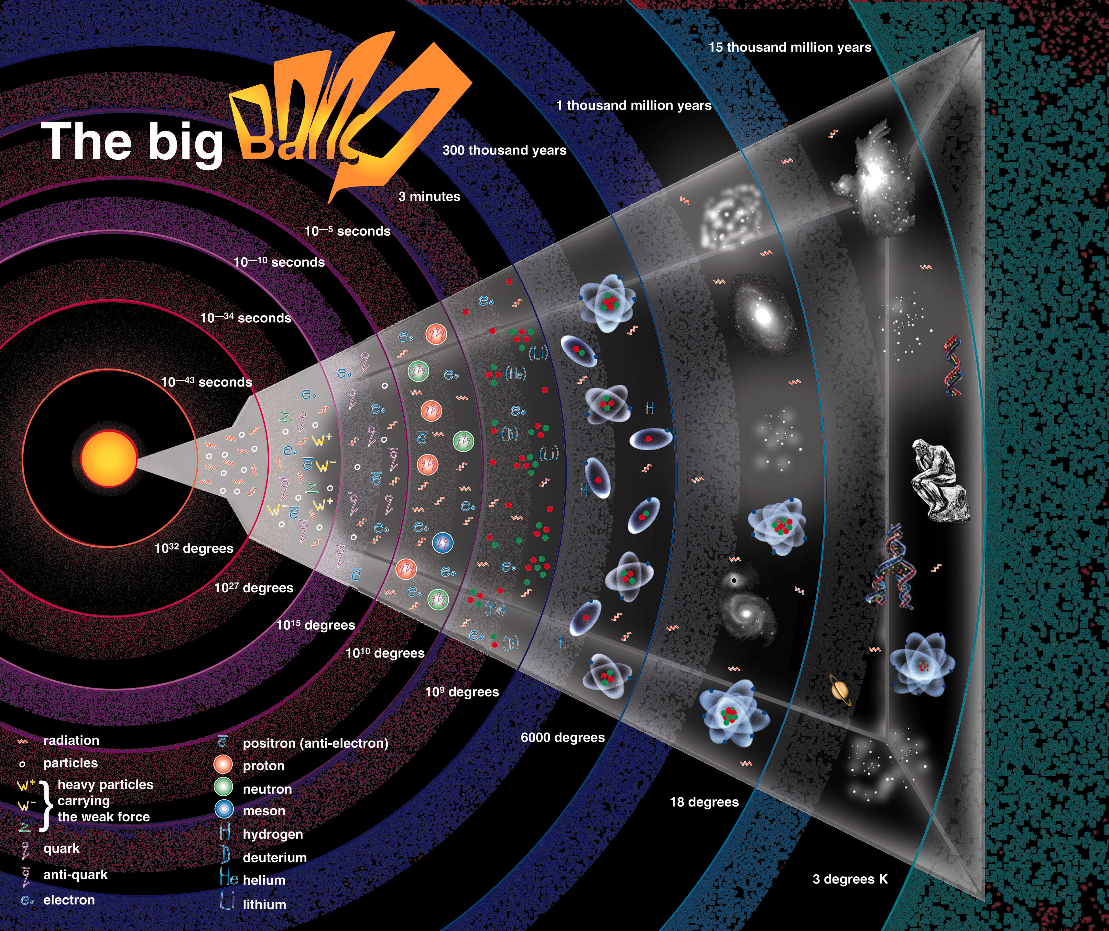
Not to scale!
Dark matter
?
Elementary particles (Cold dark matter)
t = 13.7 billion yrs

Slide 6

350,000 yrs after BB → first (H) atoms form → radiation can escape
Radiation cools
The first light in our Universe
t = 13.7 billion yrs

Slide 7
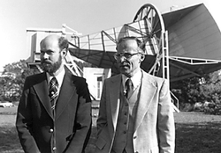
The echo of the Big Bang
In 1964, Arno Penzias & Bob Wilson were carrying out experiments using a microwave antenna for satellite communications.
As they pointed the antenna towards the sky, the receiver registered a faint ‘hiss’ coming from all directions.
They had discovered the Big Bang
The cosmic microwave background radiation

Slide 8
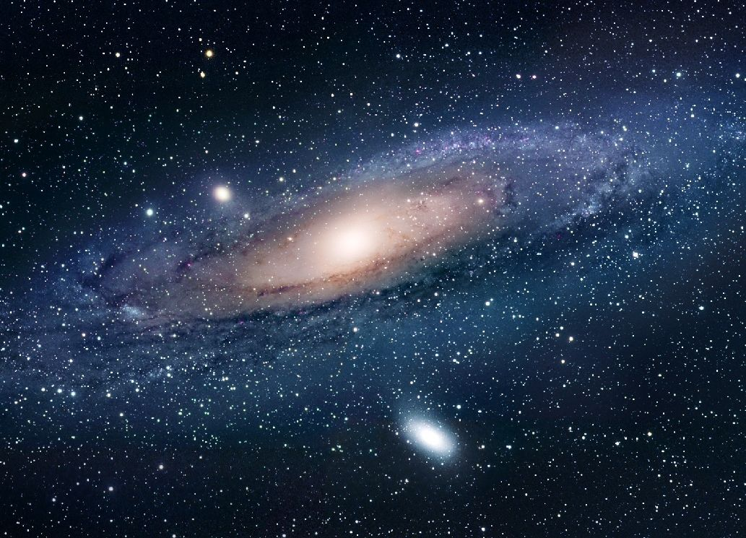
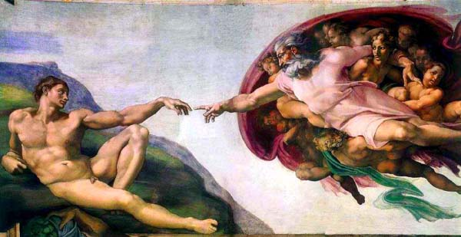
The gravity of the dark matter drives formation of galaxies & cosmic structure
Where do the galaxies come from?

Slide 9
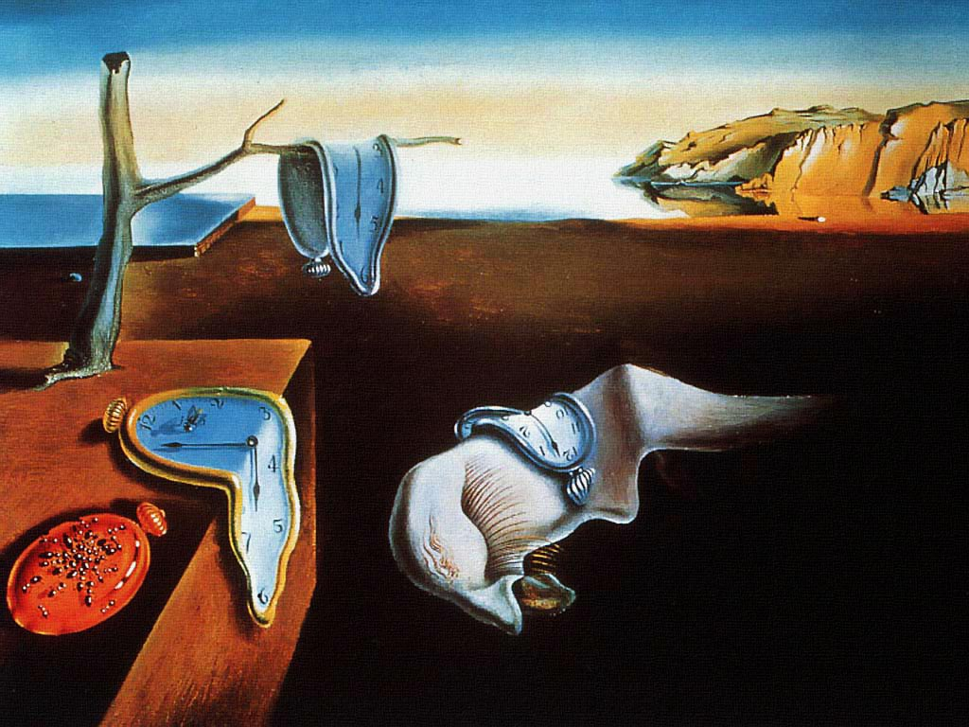

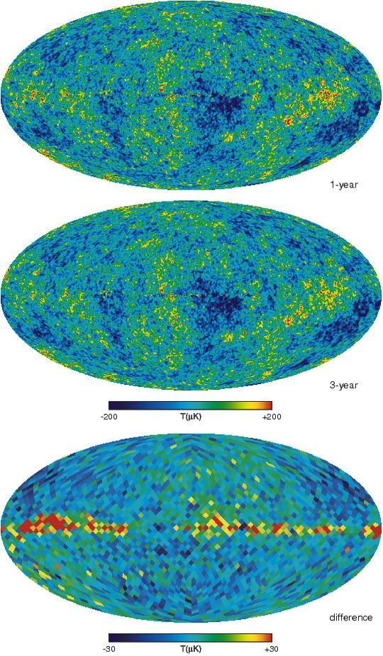
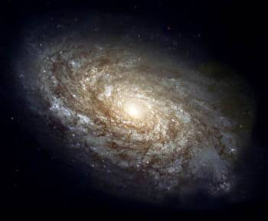
The temperature of this radiation should show small irregularities
t=0.00000000000000000000000000000000001 sec
Production of dark matter
(t ~ 10⁻¹⁰ s)
t = 13.7 billion yrs
Cosmic inflation → (t ~ 10⁻³⁵ s)
Quantum fluctuations
→ Initial conditions

Slide 10
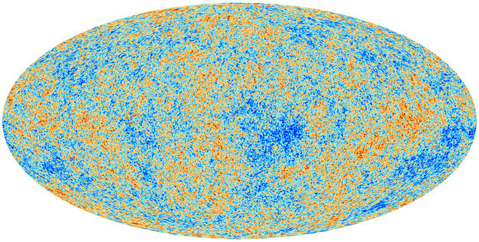
The initial conditions for galaxy formation
Quantum fluctuations from inflation
Planck collaboration ‘13

Slide 11
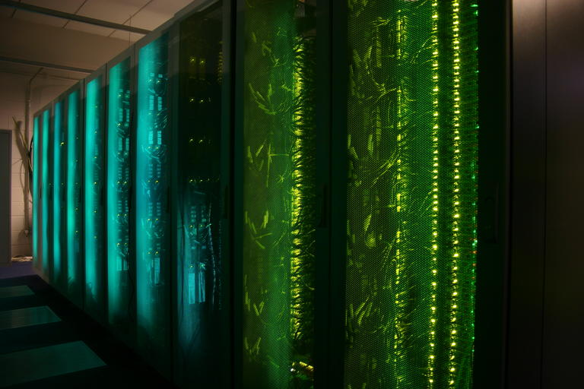
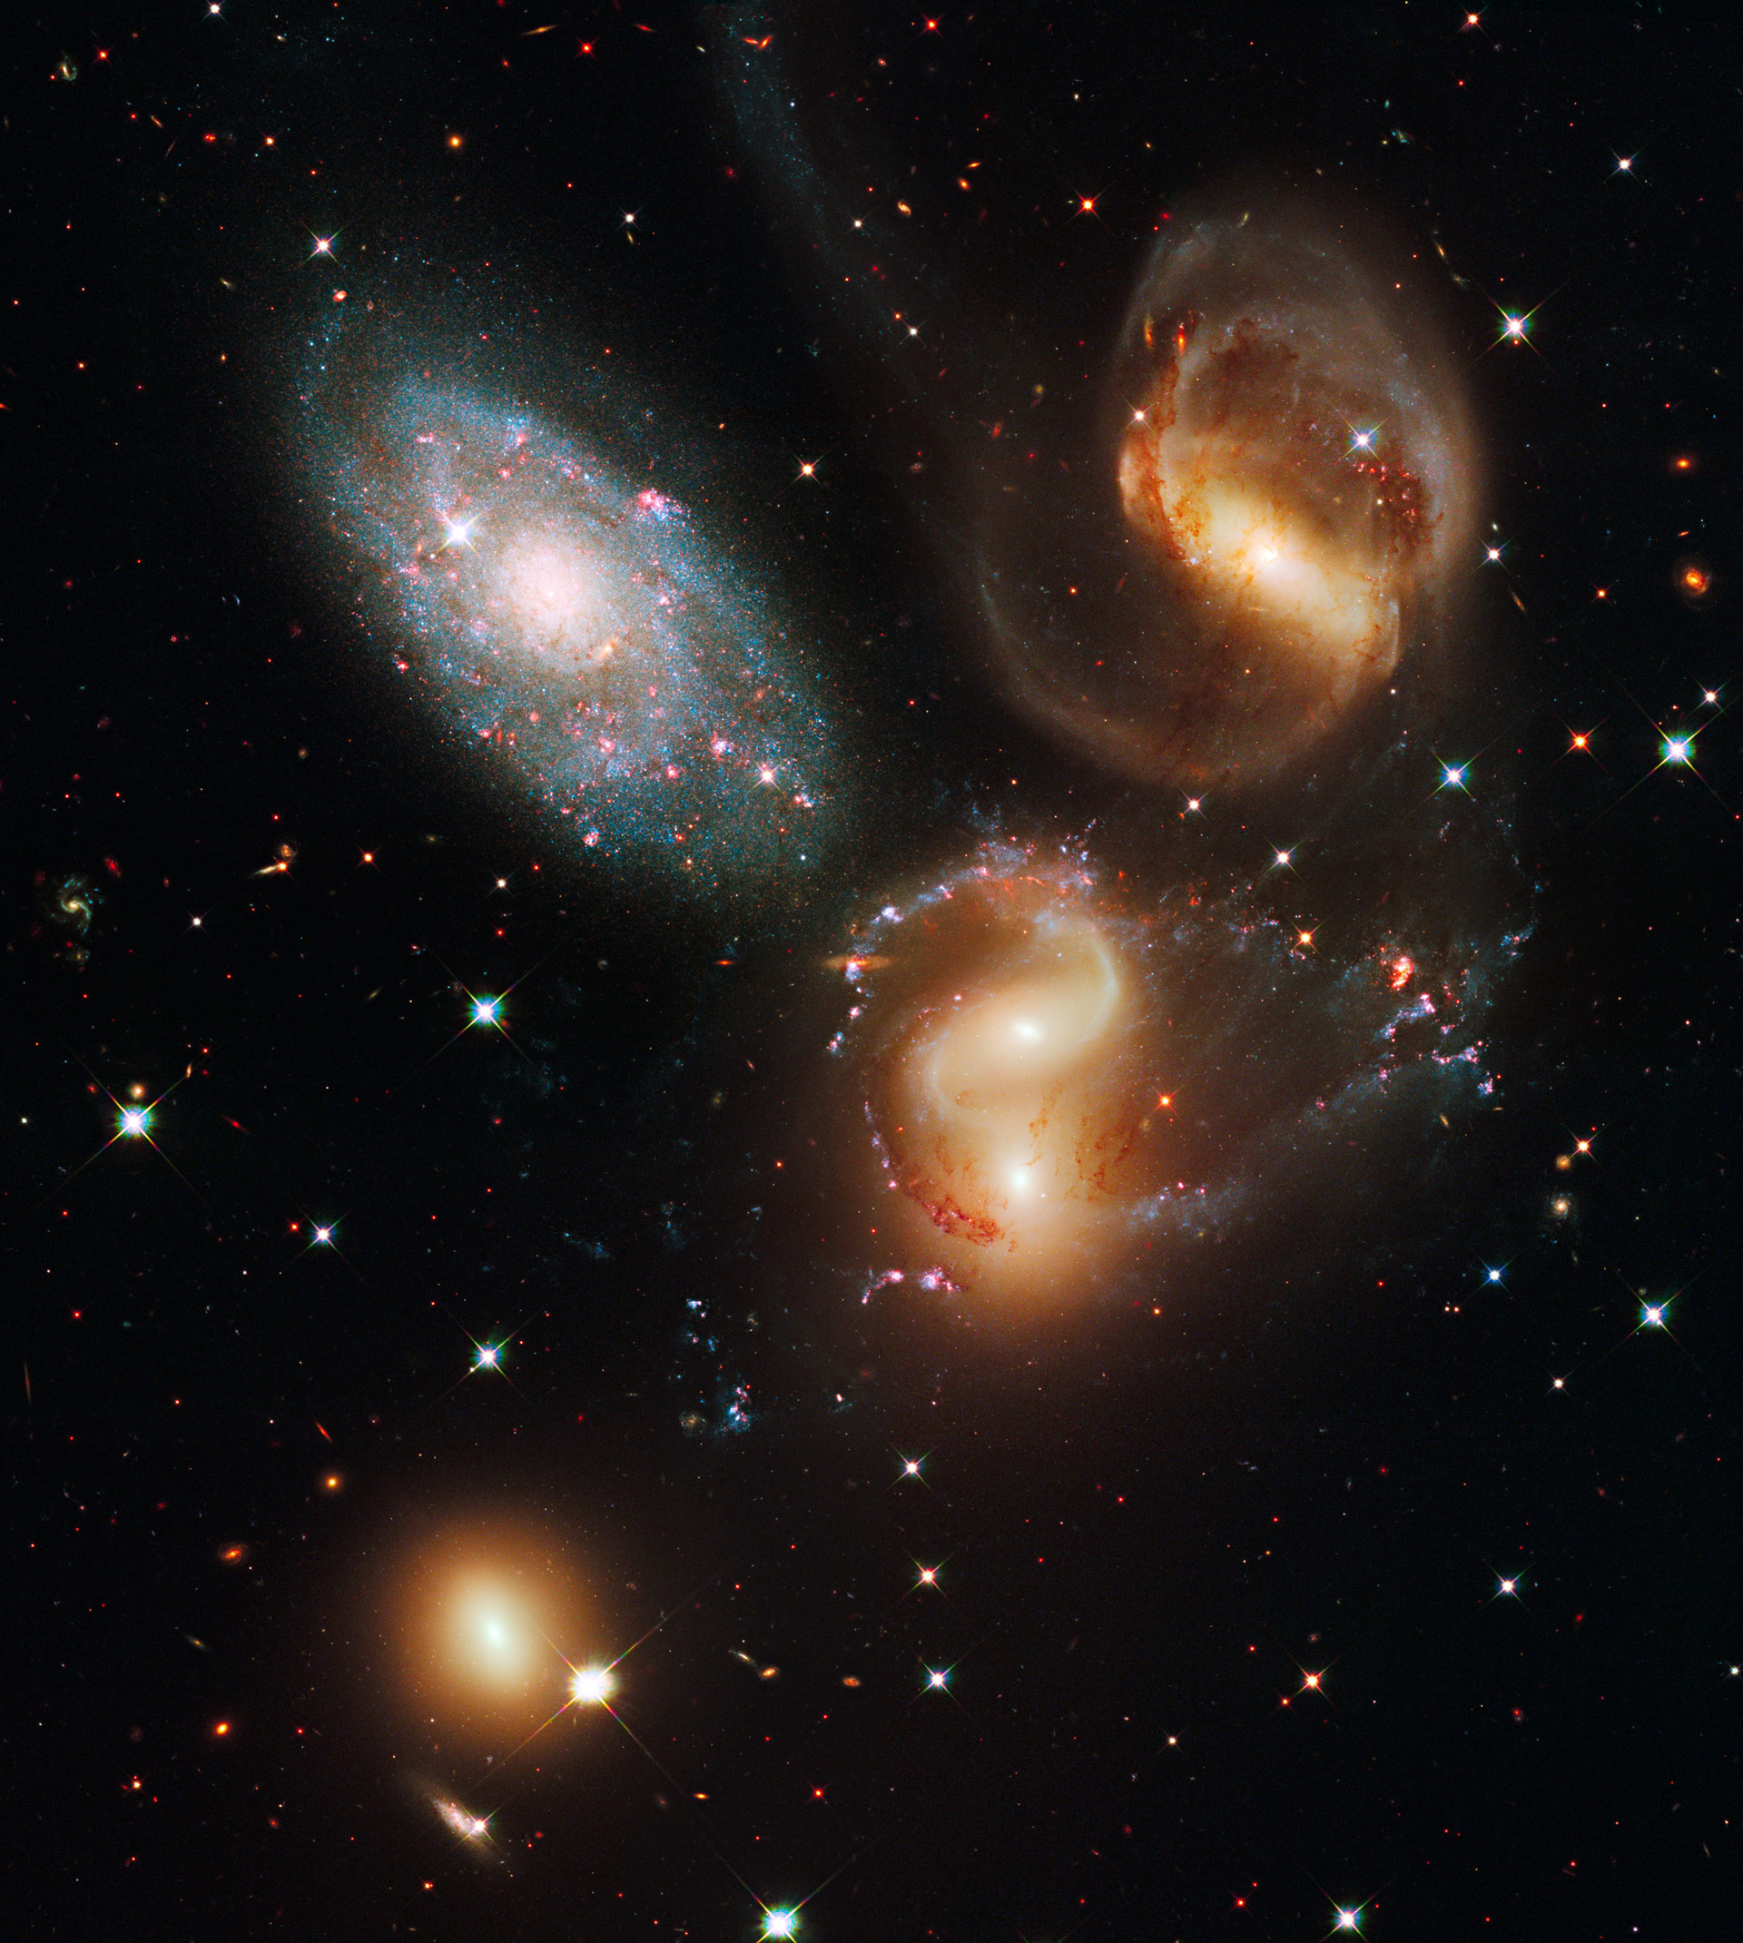
How to make a virtual universe
Initial conditions + assumption about content of Universe
Equations of physics: General Relativity Dynamics Radiative hydrodynamics
Atomic physics, etc

Slide 12


Slide 13
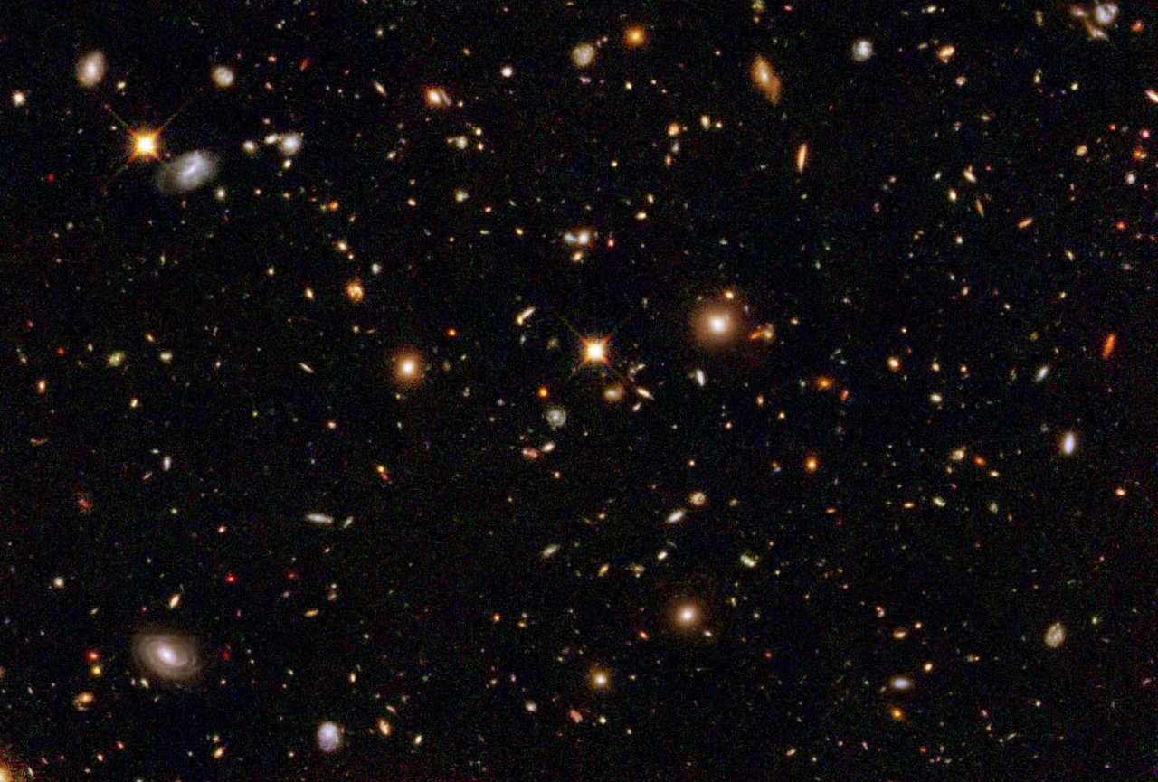
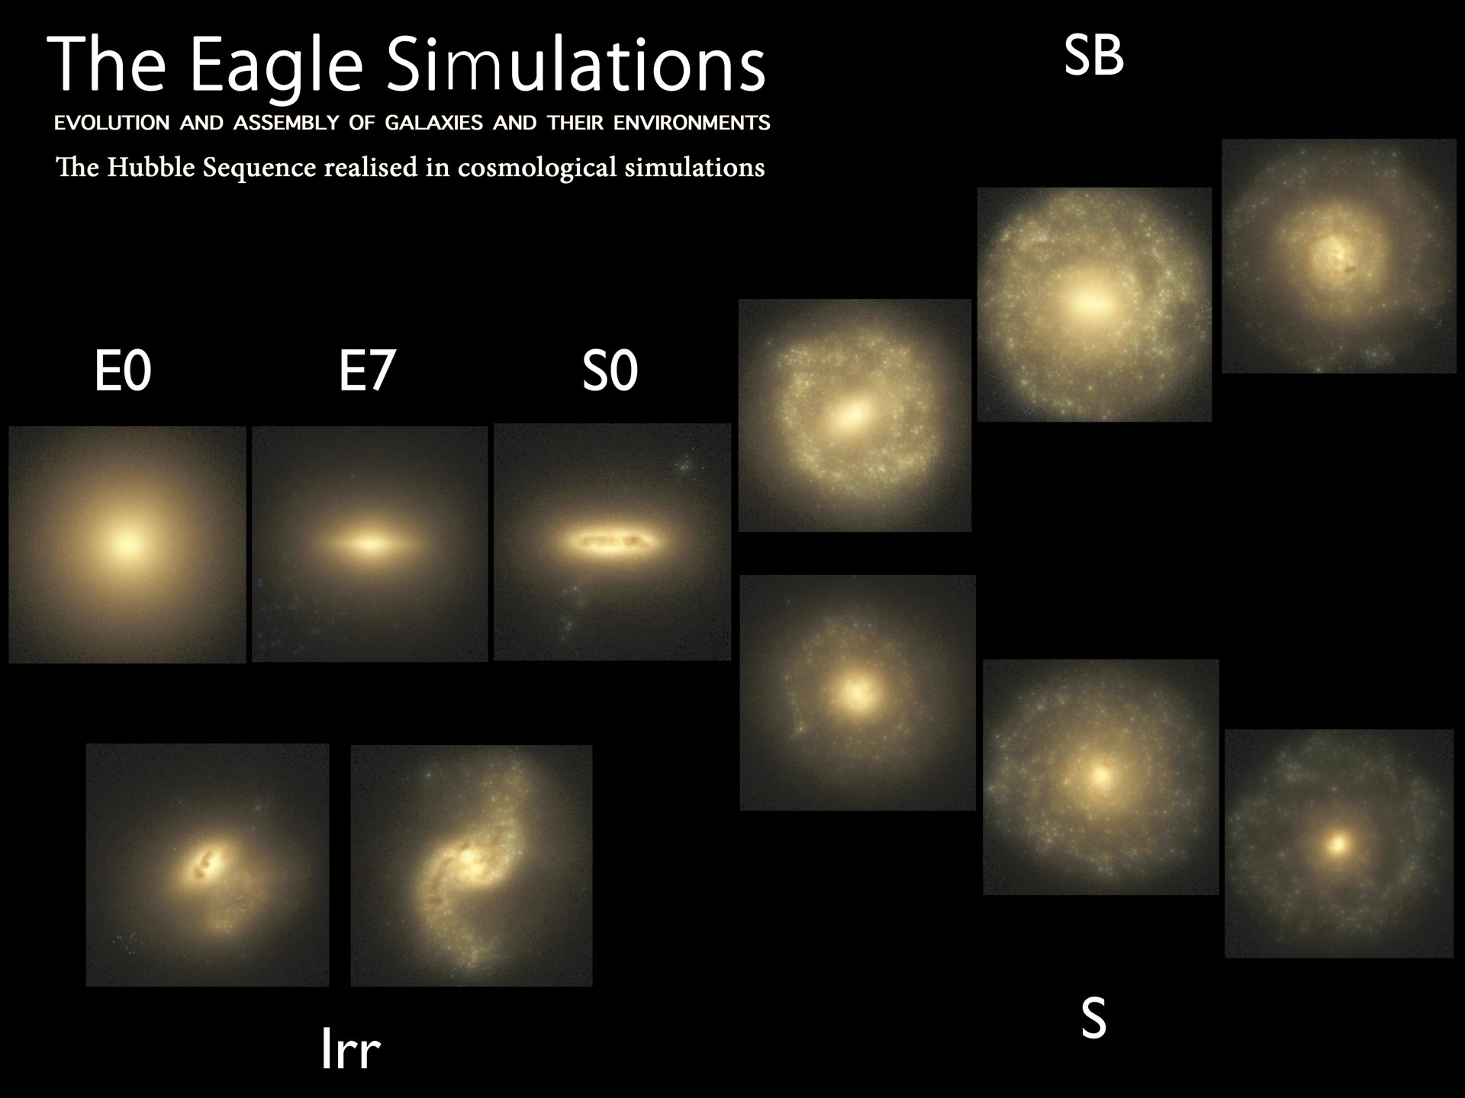
Trayford et al ‘15

Slide 14

The end of our World
Albrecht Durer 1479-1528

Slide 15
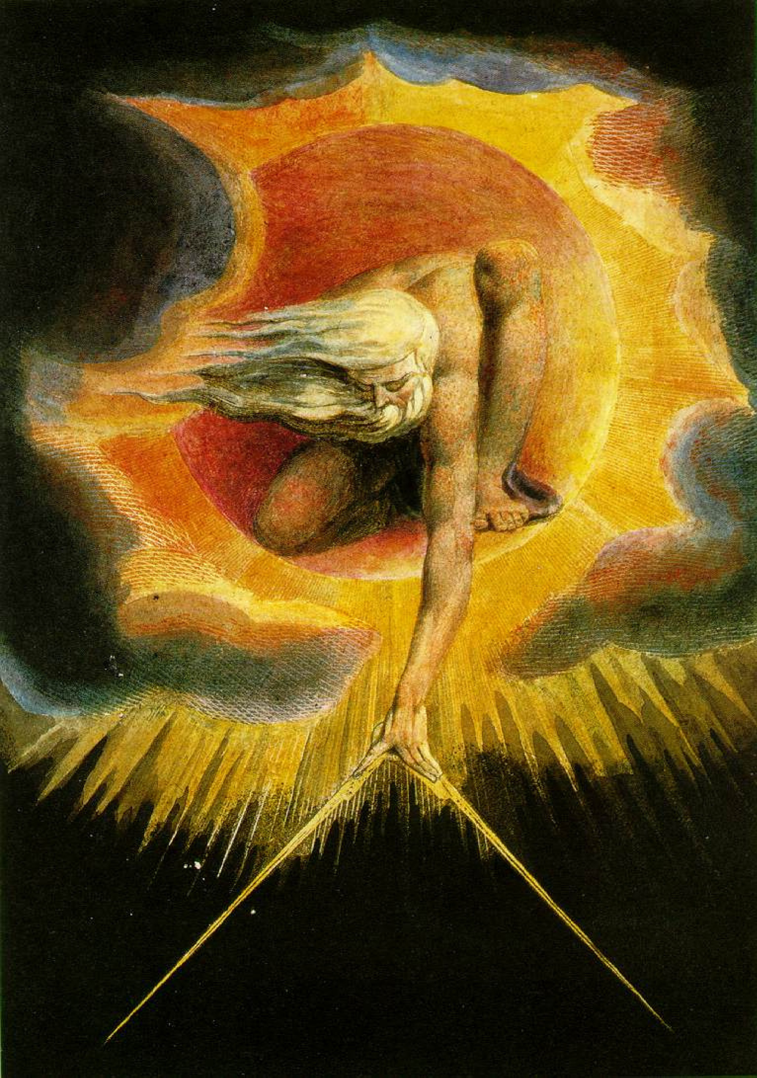
The end of our World
To understand the end of the Universe, we first need to understand its beginning and evolution
ΛCDM

Slide 16

The far future of the Universe

Slide 17
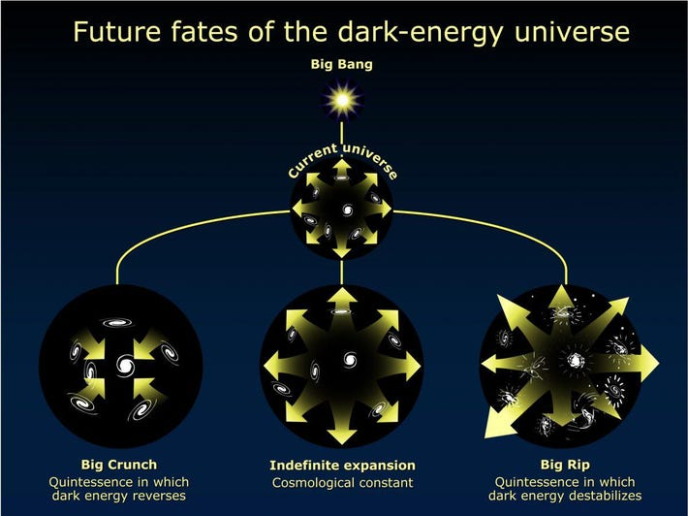
The far future of the Universe
The future of the universe depends on the behaviour of the dark energy

Slide 18
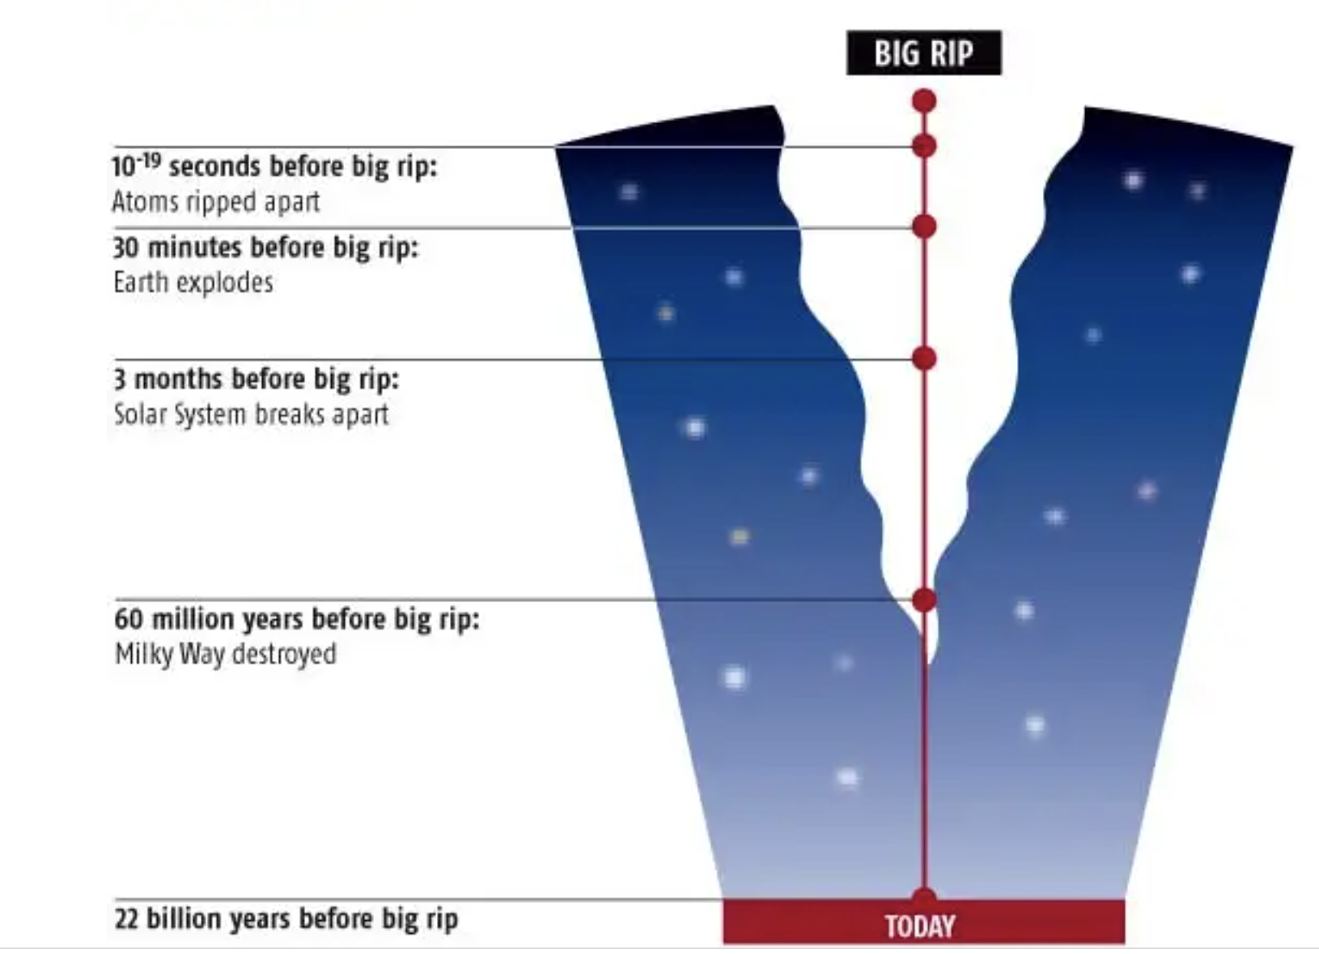
The Big Rip
With “phantom” dark energy, the energy density increases with time; the expansion accelerates at an increasing rate; horizon shrinks to 0 and a singularity forms
Unphysical! (Very unlikely)
From New Scientist

Slide 19
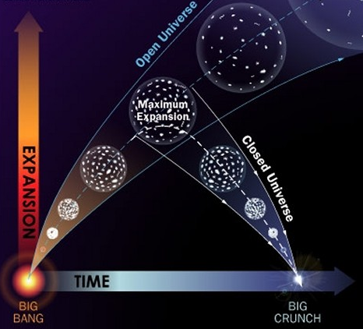
The Big Crunch
If the dark energy diminishes with time, the Universe reaches a maximum size and recolapses into a singularity
Could give rise to a ”cyclical” universe

Slide 20
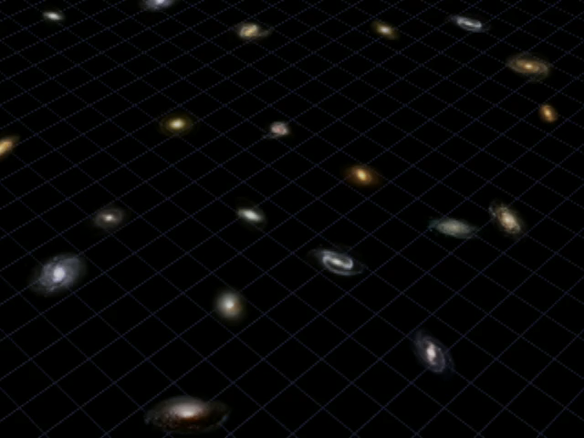
Greg Bacon (STScI)

Slide 21

The far future of the Universe
The simplest form of dark energy
The simplest for of dark energy is Einstein’s cosmological constant, Λ
→ ΛCDM
This is the way the world ends This is the way the world ends This is the way the world ends Not with a bang but a whimper
This energy density is constant in time and simply accelerates the cosmic expansion
T S Elliot
“The Hollow Men” 1925
Universe approaches equilibrium (maximum entropy or ”Heat death”)
Kazimir Malevich 1915
In 10¹⁰⁵ billion years

